Slide 1
Our Time
is
Now?!
10th November 2022
George Probert, Natasha Hill, Luke Upshall
Notes:
OUR TIME IS NOW – But what does that mean?
We are the under 30’s trio here today to discuss with you all what we see as the main Challenges and benefits over the next 5 years
We will also be discussing our expectations of how digital will progress and our thoughts on how we could all work smarter to achieve those aims.
Please just be aware We don’t have all the answers, but our presentation may highlight or trigger solutions.

Slide 2
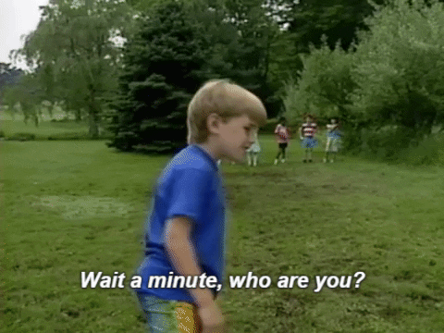
Notes:
INTRO
George
Luke Upshall 26 years old Senior Digital Project Manager for Mid Yorkshire Hospitals
Natasha Hill 27 years old – Delivery Project Support Administrator for the ICB, IDS, WY Health and Care Partnership in Leeds
Have a general view on Digital Services
These are just the things we have picked up within our lengths of services and our day-to-day roles

Slide 3
The Survey
Notes:
So as soon as we got the opportunity to present to the conference we thought… – that sounds like a lot of work - how can we delegate it?
We put together a Microsoft Forms questionnaire with 15 questions and sent these out to colleagues within our organisations because of how influential data is to Digital.
We received over 150 responses from colleagues in varying roles. Throughout the presentation any graphs or charts you see are referring to this data.

Slide 4
Communication
&
Engagement
Notes:
1 – Communication/Engagement
Background
Communication is society is now more important than ever with an ever-evolving variety of communications channels available to use.
These span all generations and backgrounds making it imperative that they are accessible and used effectively
The outcome of communications is engagement, which need to work hand in hand to ensure exceptions are met and confidence levels remain high
Charts/Graphs reference
Generational Gap
Passing information down to other generations (before retirement)
How different generations communicate?
Data sharing – Engaging with other Trusts
Reducing duplication of work
Knowledge sharing
How do we share information with clinical teams?
Lessons learnt
Hybrid Working/Teams
Link in with statistics pointing to Teams being a great benefit
How can we set up more forums (like NHS collab) to share info with other trusts to reduce duplication of work
Lessons learnt
How can you encourage your staff to continue tacit knowledge sharing when hybrid working?
For productivity/wellbeing
Encourage the face-to-face element where possible not to exclude technophobes
Encourage visibility
Body language
Disconnect from the patient at the end of processes due to WFH
Recording meetings
Hybird Working – Over X% either mentioned Teams or Hybrid working as a benefit of Digital. Teams is a necessity for our roles, but how can we use it optimally?
- Make use of built in FREE apps such as Microsoft planner, ensure that just because it's a Teams meeting there is still an agenda with clear objectives defined, set up more channels for communication between NHS Trusts at all levels, work in ways to increase tacit knowledge sharing and finally ensure face to face meetings are still happening! There's no doubt Teams is the most flexible way to have a meeting, but we still need to capture the benefits of face to face meetings – time in between them, body language, more inclusion and engagement to those less technically confident. How do we reduce communication/information overload?

Slide 5
Communication & Engagement
Notes:
1 – Communication/Engagement
First up we have our Communications and Engagement section
Communication and engagement in society is more imperative now than it has ever been as we have an ever-evolving variety of communication channels availability to use.
Within our initial research we found that we have 5 different generations all working within the NHS.
From Maturists right down to Gen Z
But what does this show
It shows broadly that the way we all communicate and engage are completely different to each other – some preferring formal engagement and or face to face meetings to virtually, with Memes
I don’t know about you, but I have sat through death by PowerPoints – with over 100 slides for discussion
Black, white, no imagery or colour.
This bores me, I lose concentration, I lose the flow of the discussion and I know I am not the only person.
And this is where our presentation comes in
Since technology has grown, we started to see more use of emojis, memes to gif’s, I utilise these on a day-to-day basis to express a feeling when text isn’t enough
A big conversation point we had as a group, was how to keep things fresh and on topic and to highlight where our differences meet – and it was a clear group consensus that this is the way we can express this!
From this you’ll be able to see throughout this presentation – we have utilised memes gifs break up this presentation – hopefully you can see why we have gone down in this direction!

Slide 6
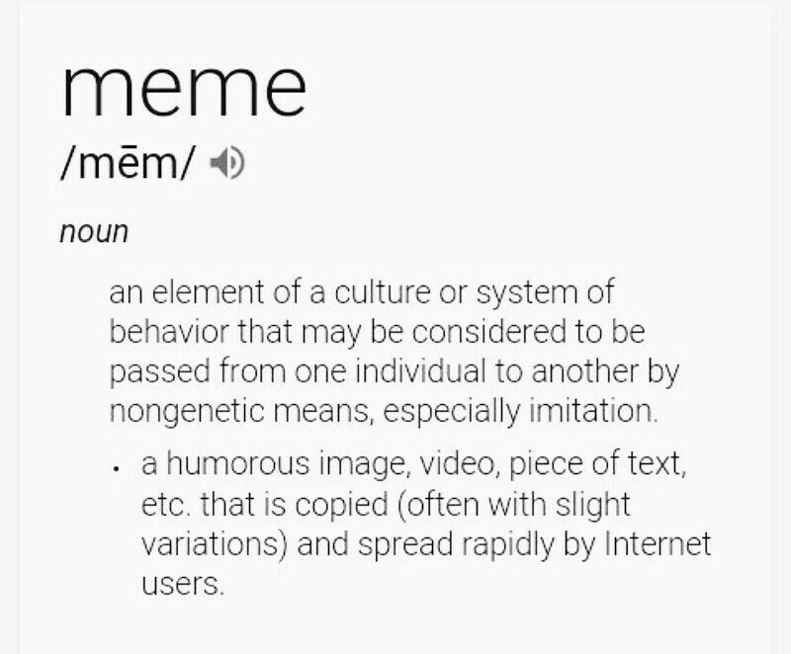
Communication & Engagement
Notes:
1 – Communication/Engagement

Slide 7
Communication & Engagement
Notes:
1 – Communication/Engagement

Slide 8
Communication & Engagement
Notes:
1 – Communication/Engagement
From this you’ll be able to see throughout this presentation – we have utilised memes gifs break up this presentation – hopefully you can see why we have gone down in this direction!
If we just look 20 years ago, it was the real start of technology and the move towards our digital overlords –
with our obsession with our phones, it started off small
with google making its public appearance in 2004
Facebook also first came out in 2004
I Phone brought their first phone out in 2007
Even if you take the floppy disk to USB Flash drives – you are talking 80000 times the storage capabilities! Just within 20 years
But what does this all mean?
It means that us Gen Y’s and above saw the change from nothing to everything in terms of technology growth
however, for Gen Y’s this happened all within in our childhoods. Having that benefit of growing up with technology allowed us time to play, mess around, establish shortcuts and utilise technology in a way that allowed it to grow and become this overpowerful digital overlord we see today.
I believe that no one ever considered just how big the internet and digital would be! I mean at the time internet safety wasn’t even a thought.
It also means the majority of Gen Z’s would have no recollection of what it used to be like without technology and some ways I see that as a negative as they will have less of an understanding of what previous generations had to overcome and the processes that were in place!
I do feel that because of the way we used digital and expressed our views on the internet and the way we approached digital is very different to the generations above Gen Y,
For example, when sending an email – I like to keep it short to the point – a lot of the time this may come across as short and rude, however, on the other side of the fence you may get
– more long winded, complex wording, losing the point to the email – to much words that people don’t read and from that if there are multiple requests through them paragraphs, that gets missed –
whereas I find if you bullet point, highlight what is required, keeping it short and sweet, I get more results.
And then what you get here is a pretty classic generational misunderstanding

Slide 9
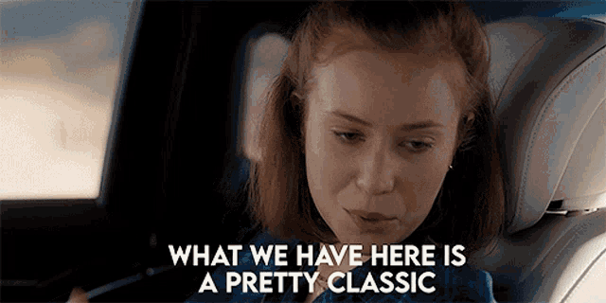
Communications & Engagement
Notes:
1 – Communication/Engagement
And then what you get here is a pretty classic generational misunderstanding

Slide 10
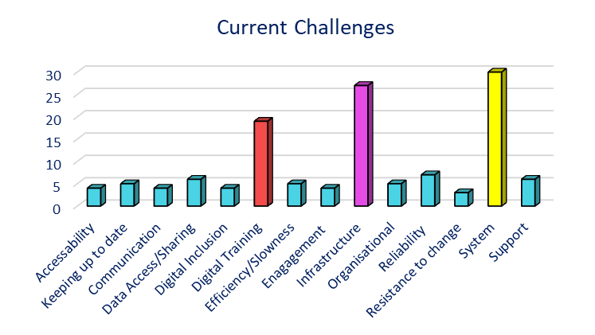
Communication & Engagement
Notes:
Current Challenges
Whenever I’m asked in interviews, what I think the most important aspect of my role is I have always said communication. In Digital, you could have the latest ad greatest technologies, a multitude of the brightest staff and the most streamlined processes, however if you can't individually or collectively work together to communicate that, it will mean very little.
Challenges with always affect how communication and engagement is handled which is why we included a question in our survey around the current challenges staff face in their workplace. As you can see from this graph, there are 3 areas within Digital that staff feel they struggle with the most.
Firstly Systems. The number of systems that are implemented in the NHS has clearly increased over the years. This will continue as more paper-based systems move to digital, and the processes are adapted cater for them. Particularly in clinical settings, staff may be required to interact with over 5 different systems just to undertake their clinical work. For staff who maybe aren't digitally minded, this can cause confusion and frustration for them. Often leading to a disconnect between them and the digital aspects of there role. Digitals reputation can become tarnished as its seen less as a support mechanism and more of a hindrance to their day-to-day work. So, for people here responsible for systems at their organisations or , how confident are you that staff and services are correctly engaged with the systems they interact with? How may of you have been in the working environments where multiple systems are used whilst conducting the job they were trained to do? What steps are you taking to ensure fluidity in the systems used in your organisations?
Infrastructure – Working side by side with systems, needs to be the infrastructure. Even to this day, technology as a whole in the public sector is known for feeling behind the times compared to private sector. Often by the time we’ve spent the money and resource on upgrading or replacing infrastructure that is outdated and unsupported, we’re chasing our tails as those deadlines come round again. There will be countless examples from people here where Windows XP and Windows 7 is still being relied on or staff who come to work turn their PC’s on and leave their desk for 10 - 15mins whilst the machine takes its sweet time in to get into a state where it can be used to begin their work. Staff and services have become so used to these issues that they don’t know any different and believe it’s the norm. I’m sure there are strategy's and plans following from many meetings on how these legacy issues can be resolved, but sometimes they come to late, and you get hit with an experience that sticks with you. This happened to be during my first full time role in a health care setting working as IT Project Support in Palliative care for an adult hospice. The long and short of which it was a Friday afternoon, and I was called over by the ward manager to the Inpatient Unit to see if I could investigate an issue a patient was having with the wifi. The wifi set up was a small ancient hub stashed away in the doctor's office with a myriad of wires coming out the back of it. Upon meeting the patient, he was trying to access the internet on his tablet to show his wife a recipe, however after troubleshooting the issue for the rest of the day, I just couldn’t get a connection and the signal strength to reach his bay. I said I would return on Monday with a couple of other solutions to get this resolved. He laughed frustratingly but thanked me for his time. The laugh stuck with me the whole weekend. First thing Monday morning I was armed with a couple of different hubs, a wifi booster and additional cables to try out and went straight to the patients bay. The patient's bay was empty, he had passed away the day before. He laughed because he knew we was expected to make it through the weekend and was of his last memories was that he couldn’t connect to wifi. I was gutted and embarrassed.
Digital Training – Finally to assist with the other 2 challenges mentioned is training. The amount of training required and knowledge that needs to be retained is ever growing and can very quickly become overwhelming. The more technology that is implemented, increases the demand on training sessions and the types of training needs that must be met. The types of training channels must be expanded on, it is no longer viable to just have a word document guide when the functionality of interactive learning can be included where staff can get their hands on a system and learn by real world examples. Follow up support for training must also be considered, where staff can refer to a variety of clear and accessible information or contact digital champion that may sit within a digital team or their service. How often is your training reviewed and kept up to date in line with technology upgrades or service improvements? Could a general overview of digital training be included at an earlier stage in education, for example whilst undertaking clinical qualifications where they could be shown the types of hardware and software, they are likely to use and well as an explanation to the terminologies they will come across. The sooner that digital interaction is put in place, the easier it will be for staff to pick this up in their roles.

Slide 11
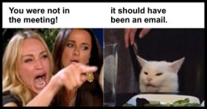
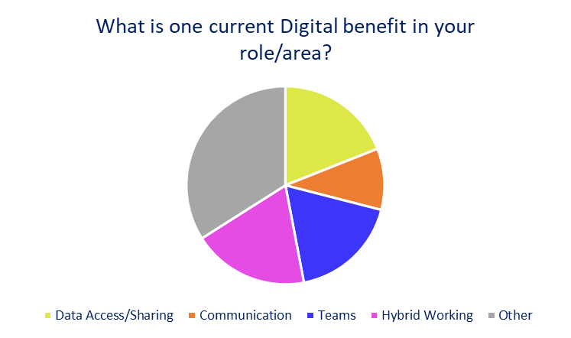
Communication & Engagement
Notes:
So, when we look at the responses to the survey, we can see that 46% of respondents felt that Communication, Teams & Hybrid Working were the greatest current Digital benefit – with 36% suggesting Hybrid Working & Teams.
Teams is a necessity for communication across the NHS – but how do we ensure we are using it optimally? And how do we ensure best practices of the past are maintained.
So What is available with Teams? We’ve got
Built in productivity applications like Microsoft Planner – and this is how our technical team keep track of projects – is this something your organisation are making use of this? Is this something that is advertised outside of Digital Departments?
We also have Cross organisational forums such as NHS local administrator collaboration – how can we increase the number of forums and collate a knowledge base of lessons learnt and solutions for more workstreams? In the creation of this presentation Luke has told me some lessons learnt for our pending Imprivata Deployment- but it would be great to have more opportunities to facilitate data sharing
With Teams we move to Instant messaging – with this type of messaging - People expecting responses instantly – expectations need to be managed so there is less stress on our colleagues as soon as a message is sent and we aren’t distracted from what we are working on
What are we missing?
Body language – you’ll all probably be aware that 55% of communication is body language which is lost with Teams. Encourage use of Slido/Reactions on calls to maintain this method of communication
Lack of Tacit Knowledge Sharing when WFH – How can we encourage this with hybrid working?
Visual collaboration tools – aforementioned Microsoft Planner!
OneNote knowledgebases
Setting up informal group discussions outside of working silos
Face to face meetings should still be encouraged within our work weeks. Great for communication especially with technophobes and allow for a nice rest period between meetings
One final consideration for WFH is a Disconnect from the patient at the end of processes – how can we ensure this remains at the front of our minds?

Slide 12
Workforce
Notes:
2 – Workforce
Background
Charts/Graphs reference
- Are you aware of any initiatives to attract younger generations into Digital roles? Over 81% said no
Hidden Disabilities
Anxiety/Dyslexia/Behaviour
Use of new technologies to support these members of staff – Teams recording instead of paper notes, transcription for example
Retaining Skilled members of staff
- Hybrid working
Pay !!!
Overhwelmed/pressure - link to pay
Coureses - have to pay if leave within X months
Career planning/appraisals (should be 6 months)
Attracting skilled members of staff (Apprenticeships/Work Experience)
Mention joining work experience
Mention apprenticeship opportunities GP
Point to statistics X amount of people aren’t aware of opportunities. Point to age discrepancies
Completed funded from the government (UHDB has 1.2 Mil allowance annually) only resource is TIME
How are YOU going to engage with the younger staff – reach out to local Uni/College/Sixth Form. Elect an apprenticeship champion/ambassador. Look at T level, interns, apprenticeships, work experience.
How are we going to link in with younger members of the clinical workforce to ensure we have good foundations Digitally for the next clinical generation
Don’t just look at apprenticeship opportunities for new staff – where can we utilise these schemes for developing our existing staff?

Slide 13
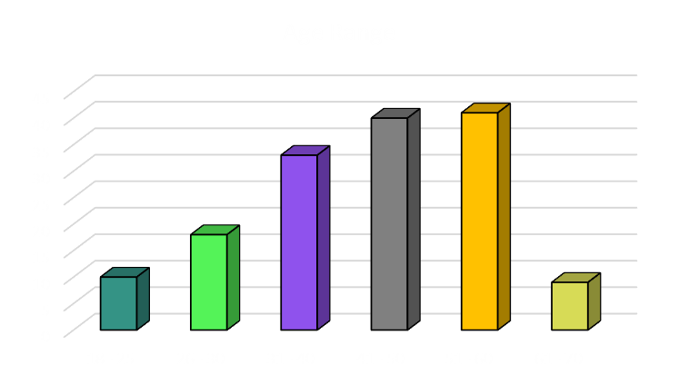
Workforce
Notes:
2 – Workforce
Next up is Workforce!
But first why we - the under 30’s here?????
We were invited by a senior member to a put an application in as part of the ‘Rising Star’ and we were required to write 500 words on why we should be invited to the event, what we would present on and how we would come together with the 2 other applications you see here with me today – out of us 3 there was xxxx amount of other applications interesting in coming to speak with you – that to me shouts volumes, it says to me that we want to be here, we are interested in what happens, we want our voice heard.
And not just cos there is free food..
But on a serious note, I want to be the first to say how excited we are that you have given us under 30s the ability to speak here today!
At this point I need to direct you to the graph!
– this was a huge one for me, it highlights that actually there are more people within the 31-40 age range then both the 18-25 & 26-30 age range combined!
So overall my generation has the lower population, but that to me means we might get missed off or not included
We know there isn’t much younger generation representation but If you take anything from us today, please include your younger staff,
We all know that the younger generations are more likely to job hop, we no longer seem to have the option of getting a career and working doing it for the rest of our lives as previous generations – we just don’t seem to work like that, we like to keep moving, keep things exciting, but we do want to be involved and make and see changes!
We were talking about this in our first initial meeting together - When do the younger colleagues we get the opportunity to present and discuss in front of senor staff on how we see the organisation going.
We even mentioned about it might even be worth creating a networking event very similar to this but opening it up to more individuals, showing the younger generations, lower banding, students the opportunities within the NHS and what directions you can go in and that you don’t need to do college/uni courses to get a role, you can utilise day courses, online courses to get where you need to!
We also need to stop the single point of failure – I’ve seen it too many times where experienced team members have no capacity, there are in meetings all the time – there brains are so full of knowledge its generally unbelievable when you get them going on there subject matter – but what happens when they leave, change roles, retire – more often then not this knowledge doesn’t get passed down and its up to the next person to pick up where was left and to try and work out what has been happening – this causes delays, work being duplicated and more meetings being taken up to discuss the same things that have already been discussed.
We need to give time and capacity back to the top so it gives everyone an opportunity to learn and progress. We need to stop pointless meetings that can be done as a quick message and we need to give more opportunities for people to grow and progress this organisation!

Slide 14
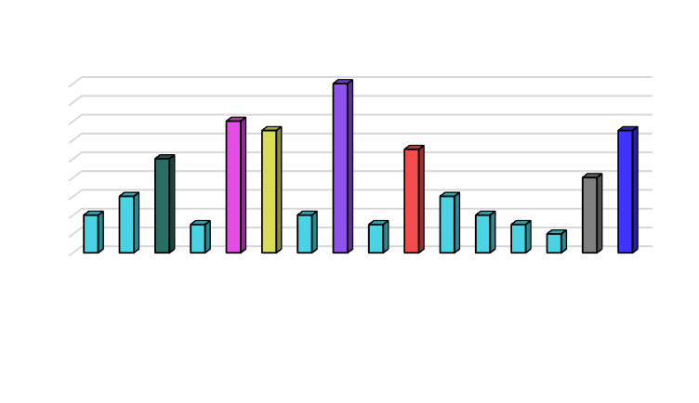
Workforce
Notes:
This graph can be quite daunting, it shows a great many challenges on the horizon. But with continued support of our workforce in terms of training, wellbeing and personal development we can maintain retention of our skilled members of staff through these times. Skilled staff retention is imperative for a productive workforce as is attracting skilled colleagues….

Slide 15
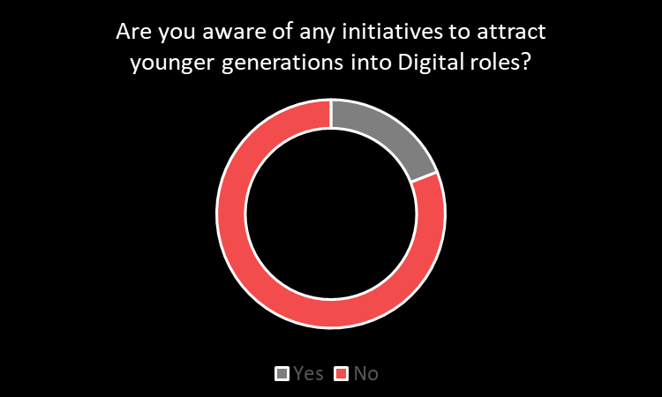
Workforce
Yes – 19%
No - 81%
Notes:
But one aspect that is often forgotten is that we can build our own skilled staff. When we look at the survey responses this is clearly an area we can work on.
As someone who visited UHDB on work experience when I was 14 and later joined as a junior role at 19 with no former IT experience - the work experience I undertook has undoubtedly shaped my career and most importantly put me in front of you all today. So, let’s explore what’s available.
Using UHDB as an example, we are given a 1.2-million-pound levy per annum dedicated to apprenticeship schemes. This is a number which we do not meet. With this scheme being funded - from a digital perspective the resource we must invest is time
We have a multitude of options available – Interns from university, Apprenticeships, Work experience and T levels which are 80% in college and 20% on the job learning
How are YOU going to engage with the younger generations? – You could reach out to local Uni/College/Sixth Form – speak to faculty members within Digital fields!
Elect an apprenticeship ambassador and where possible involve your junior colleagues in the process! We will have greater engagement if we have digitally minded colleagues representing the NHS rather than a careers advice professional.
Don’t just look at apprenticeship opportunities for new staff – where can we utilise these schemes for developing our existing staff? These schemes go all the way up to a masters degree
Finally - How are we going to link in with younger members of the clinical workforce to ensure we have good foundations Digitally for the next clinical generation – how can we bring junior doctors into discussions at an early stage so they’re aware of our limitations but also what we can do for them.

Slide 16
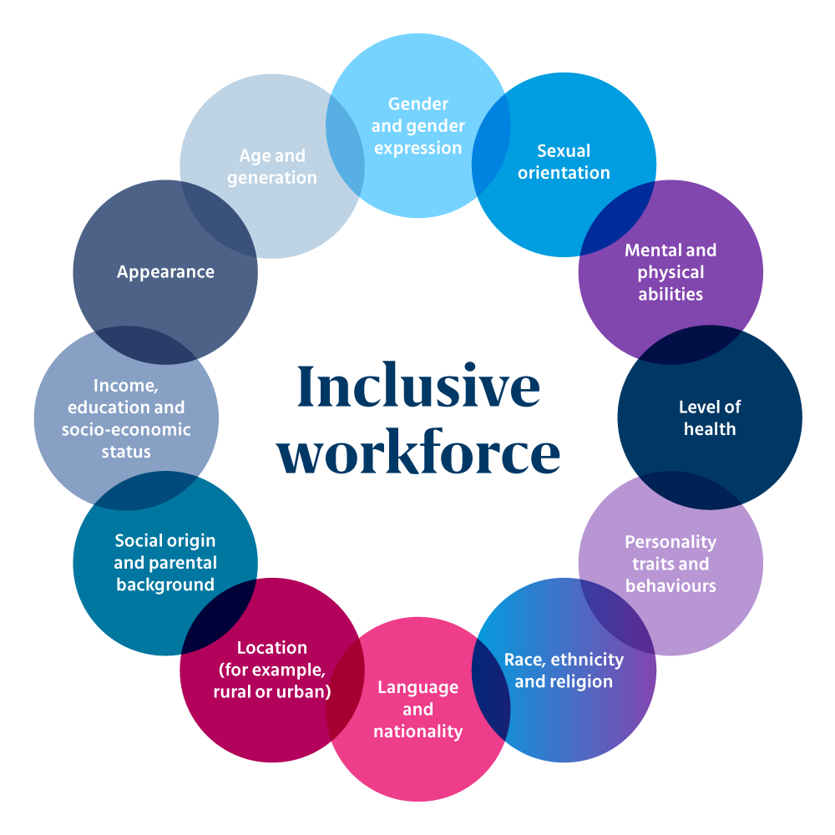
Workforce
Notes:
2 – Workforce
In todays society, the need for an inclusive workforce is more important that ever as the conversation surrounding inclusion and accessibility becomes more open. Whilst we’re not subject matter experts on these topics, younger generations are growing up to become more aware of how these can benefit their careers and feel more comfortable in any issues that arise. The legacy stereotypes are becoming a thing of the past as we aim to more away from the typical ‘IT crowd’ scenario and the topics above are now helping to shape our digital teams of future.
Examples of these are;
Increase of women in technology, initivates that allow staff to express themselves more freely regardless of gender
The open conversation surrounding anxiety and depression, topics that whether you understand or not are thing we all experience in different ways and can be talked through in health and wellbeing conversations
Flexibility in hours to accommodate personal circumstances whether that be relating to illness, family or religion
Openness in taking on staff with a variety of educational backgrounds, moving away from the traditional mandatory degree requirement and taking into consideration more work-based experience

Slide 17
Future
Notes:
– Future – Our Interests
Next section is Future –
and our interests and between us we have chosen an area we are involved in that interests us and will be impacting within the next 5 years.

Slide 18
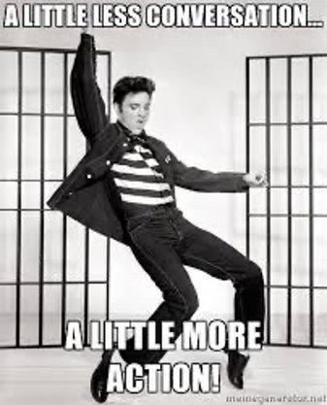
Notes:
As Elvis would say: A little less conversation and a little more action!
Between us we have chosen an area we are involved in that interests us and will be impacting within the next 5 years.

Slide 19
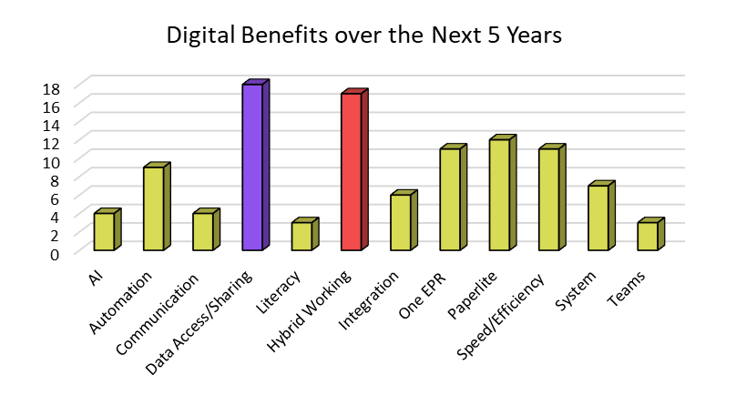
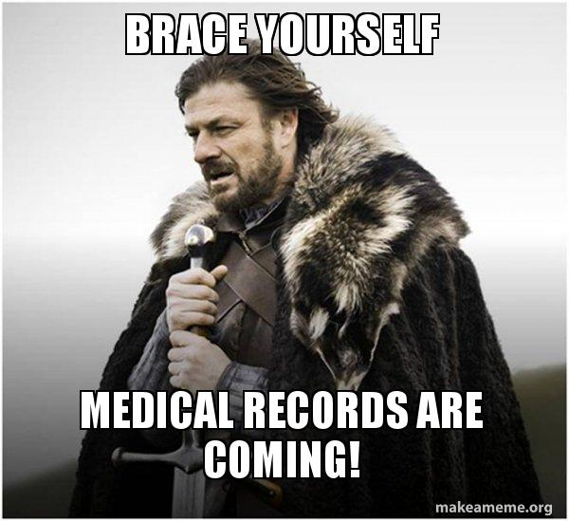
Future – Shared Care Record
Notes:
– Future – Our Interests
Next section is Future – between us we have chosen an area we are involved in that interests us and will be impacting within the next 5 years.
My Interest is within the ShCR project.
My role within this project is to provide Project Administrative Support.
We have been engaging with a large number of stakeholders across a variety of different care areas.
From this engagement we have uncovered a great need for a Shared Care Records within the system –
And if we do this right we will solve many issues, we will help to improve patient care, patient experiences, improve safety and increase our time efficiencies.
From our engagements sessions we have found that the scope of work has helped establish complex and interlinked requirements.
Each identified use case has led to multiple workshops with multiple teams to further understand them requirements in sufficient details to explore options for improvement
However, there is one clear overriding message coming out of the engagement meetings, it is no longer about winning hearts and minds about having shared care records.
The question on everyone's minds is how do we do transformational, cross organisational care for individuals where we need real time read write access to data?
We are all grappling with the same problem.
It is now about how we get this done for the city and the challenges around how do you manage governance in a complex and far-reaching programme.
I was a RAF Brat and spent a lot of time moving around the country. I but I was also a very clumsy child and spent a lot of time in hospitals and GP Practices, having something like the SHCR around during that time would have been a huge and created a massive difference in my medical care and how I was looked after and treated.
As always there are blockers on getting projects set up and to help continue to run, especially in this current environment but within the next 5 years I would love to continue to help push, share, shout from the roof tops of how this can benefit everyone, and not that we are just trying to sell data…
But in reality, due to all the political red tape for data this unfortunately isn’t something that has managed to be set up yet, but it should be down to the patient to advise.
The patient should be able to go anywhere, and health care providers included should all have access to this data to enable them to be treated appropriately.
Additionally for future proofings’ to make sure everything we go and continue to do, and other project set ups we all have the ability to collaborate and run in conjunction with this project as this is the future,
this is what is going to set us apart from everyone us, to help propelled the NHS into the future and create a new baseline for normal day to day care.

Slide 20
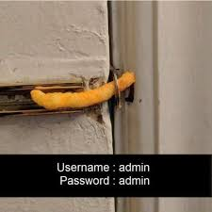
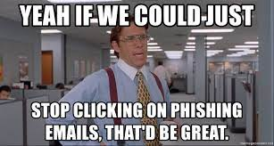
Future – Cyber Security
Mental health trusts still unable to access records months after attack (digitalhealth.net)
Notes:
When I think of the next 5 years in Digital, Cyber Security is a challenge that really stands out. Our security team has grown recently, and I envision it increasing further.
Some of the current challenges are out of date hardware such as medical devices and legacy systems – these devices can’t have the latest security patches due to their age. So how do we prevent this in the future?
Digital need to be engaging with departments and ensuring we are involved at procurement rather than retrospectively – this way we can ensure solutions are futureproofed and meet our requirements. If we follow this process, we will keep our colleagues happier as we aren’t seen to block their projects post procurement, as well as improving our compliance with DSPT. It is imperative that we remember Software Patching was one of the key lessons learnt from the WannaCry Ransomware Attack.
With improving technology such as Windows Hello using biometric authentication – we also need to ask how we can protect our organisations and colleagues from DeepFake technology – which grows more sophisticated each year. In the private sector there are reports of people using DeepFake to mimic CEO’s voices with malicious intent – could this be an issue within the NHS?
We have some great schemes in place such as the penetration testing, we are currently doing this with other NHS organisations. But could we pursue a commercial ethical hacking schedule alongside this as the need for Security increases?
There is also best practice that we need to iteratively communicate to our staff relating to Phishing attempts. Our teams are getting better at noticing these, but the scammers are getting better too. We have schemes to simulate a phising attack which are a great insight into which colleagues require more guidance. It is important to maintain a no blame culture with support for all – as these attacks can also occur in our colleagues’ personal lives too. Is it time to move all our colleagues to 2FA? Especially with the move to Sharepoint and OneDrive – is there too much at risk to allow users to continue without 2FA?
When we speak about 2FA – it makes sense to everyone in this room as to why we use it. But when it comes to clinical members of staff it is just seen as a delay to their activities – how can we communicate the importance of this process better? Or can you think of any new technologies to support in this area – such as virtual smartcards?
The article on the slide refers to a ransomware attack on an EPR supplier – affecting 12 Trusts. Attacks like these are opportunities for yourselves as leaders to assess your own organisations for a key attribute closely linking to Cyber – resilience
Do you have robust Downtime procedures in place? And most importantly are your colleagues aware of these – so that if the worst case does occur, our patients can still receive the care they need.

Slide 21
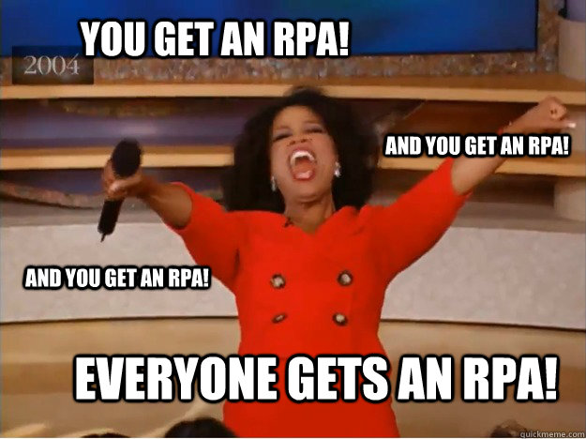
Future - Robotic Process Automation
Notes:
RPA LU
RPA, the latest buzzword surrounding the NHS as the technology is being further explored and implemented within organisations. The technology is still in its infancy, however the benefits for automation can be huge in terms of saving time and money, redefining how staff resource is used and improvements on data quality and efficiency. Using software designed to build bots, the technology is there to work alongside services to assist with tasks ranging from time consuming administration tasks such data logging to automated document collating and storing into a variety of different systems. Whilst COVID forced some of the much-needed digital agenda through, it also created a backlog of tasks spanning over 2 years in some cases. RPA can be designed to help with those backlogs, taking the ever-increasing pressure off human resource that is overstretched or simply just not in place. There is still work to be done to increase the understanding of RPA across the NHS, moving away from the stereotypes that the robots of here to take over humans and subsequent jobs will be lost.
Depending on how organisations run their RPA, an RPA team will become the norm in Digital service departments who will become responsible for managing the processes and bots that are designed to assist services. The need for additional resource will come out of the demand for RPA, some of those being
Change or business analyst – review current and future state processes and building return on investment mechanisms
Developers –building and maintaining the endless number of bots required
Testers – building robust testing scripts and scenarios ensuring the useability of the bot's long term
This is a huge opportunity for the NHS and one that needs to be structed correctly and done at pace allowing organisations to embrace its benefits.

Slide 22
Our Time
is
Now.
Notes:
SUMMARY PAGE
NH - JUST A REMINDER –
We are not the rising stars, we are just 3 under 30’s who were given the opportunity to come present today and we represent a number of people those of whom may not feel confident to take part and or management may not of given the opportunity.
GP
I’ve learnt a great deal preparing my slides for the conference. Most importantly – we are on the right path, from our adaptability to Teams, cyber initiatives and money spent training the workforce – we have strong foundations to build upon for the future. I hope our research and suggestions can be used to shape the next 5 years.
LU
Finally you’ll notice that we can changed the grammar of our time is now. We believe that this is no longer a question or a surprise. It’s a statement, OUR TIME IS NOW.

Slide 23
Thank You
10th November 2022
George Probert, Natasha Hill, Luke Upshall
Notes:
Thank you for the opportunity in allowing us to speak at the conference and taking the time to listen to our presentation

