Slide 1
Living
With
Diabetes
Patient Perspective
Elise and Rochelle Featherstone
Notes:
Dawn Greaves introduce Rochelle and Elise

Slide 2
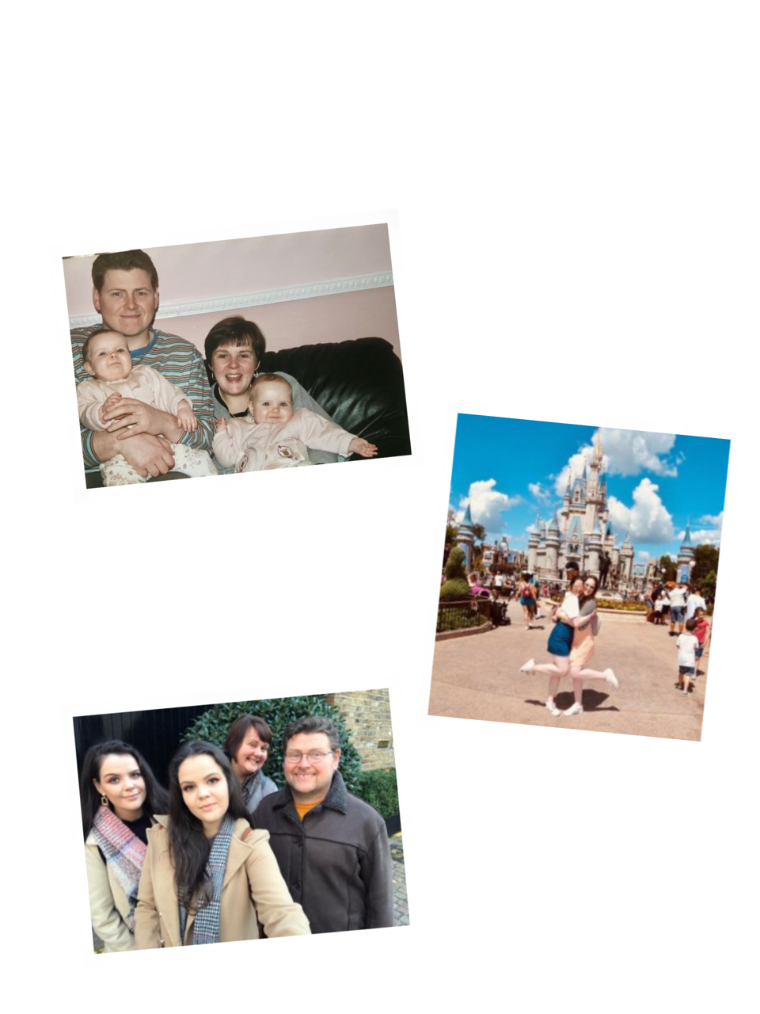
Hello there!
We are Rochelle and Elise Featherstone.
Today we are here to talk about living with Type 1 Diabetes.
Elise
Rochelle
Notes:
Hello everyone I am Elise
And I am Rochelle
I know most of you have probably picked up on the fact we look very similar, we are indeed twins and today we are here to talk to you about both of our experiences of living with Type 1 Diabetes

Slide 3
Agenda
1
Living with Diabetes
2
Digital advances
3
Where is it heading?
Notes:
So what are we going to take you through today?
Firstly what its like living with Type 1 Diabetes, including our diagnosis, our families perspective, and our condition overview
We will then be taking you through the Digital advances in Diabetes care, how its had an impact on our lives and some exciting Diabetes technology
And lasty where we think Diabetes care is heading from both a clinical and patient perspective

Slide 4
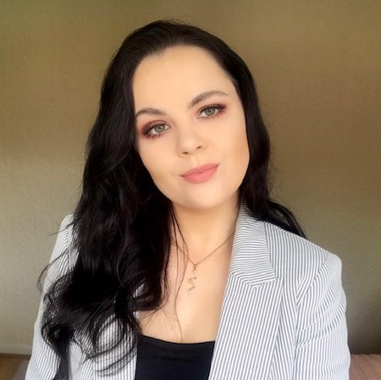
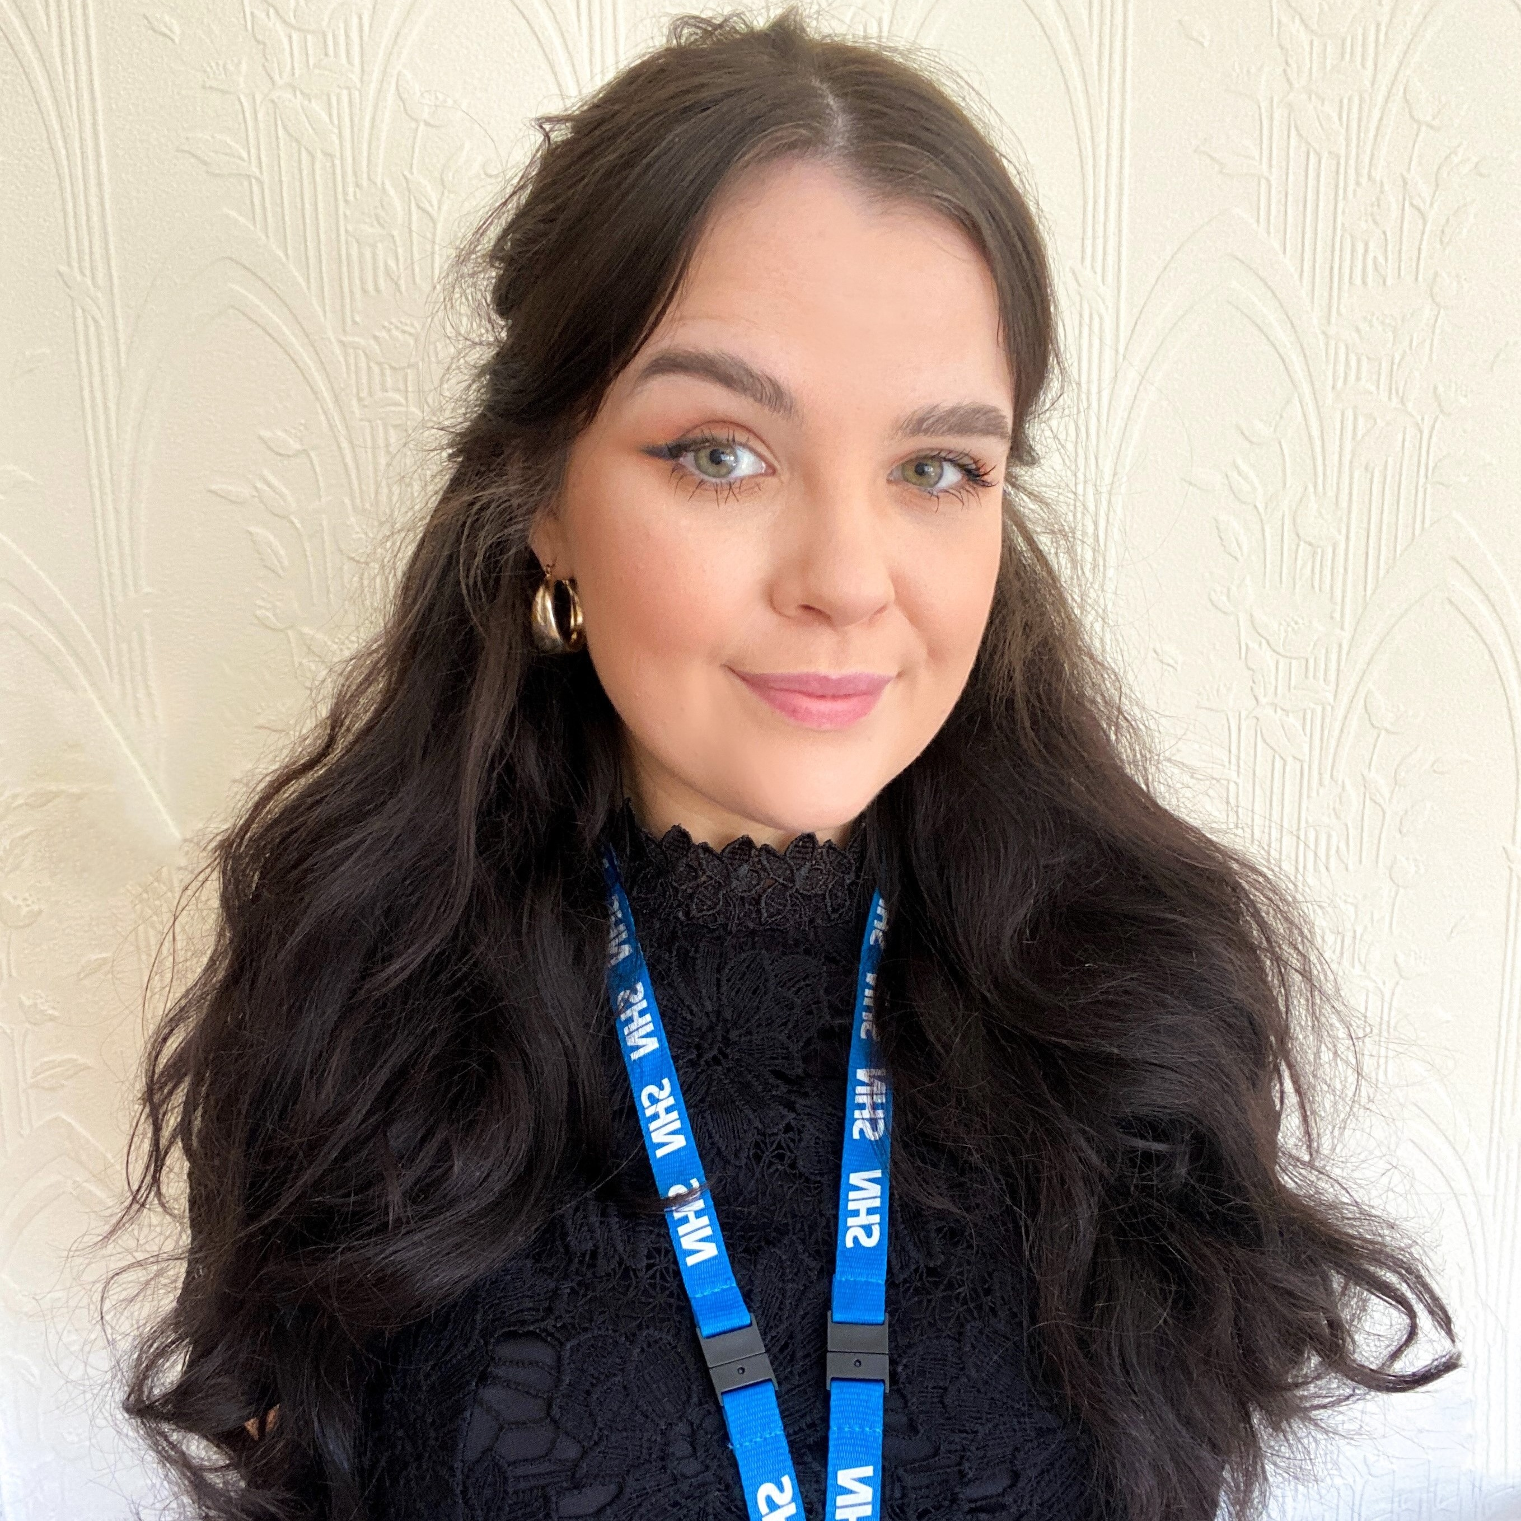
Living with Diabetes - our diagnosis
Elise Rochelle
Diagnosed
Diagnosed
2002
2003
Symptoms Symptoms
Notes:
So how long have we both been Diabetic?
We weren’t born with the condition we both developed in early childhood which is usually the case for Type 1 Diabetes
I was diagnosed in 2003 and Rochelle was diagnosed in 2005. I just want to draw your attention to the difference of when our symptoms started compared to our diagnosis, I suffered with symptoms and was quite unwell for an extensive period of time before I was diagnosed and admitted to hospital. This was due to a lack of awareness around diabetes symptoms within children at the time and mistaking the symptoms for other conditions.
There are 4 main symptoms of first diagnosis of Type 1 Diabetes. These are called the 4 T’s. Due to the extreme excess of glucose in your bloodstream you will be extremely thirsty which increases your bodies need to use the toilet to flush the excess glucose, which also linked in with tiredness and thin (thin being due to common extreme weight loss in early diagnosis) this gives us our 4 T’s of symptoms.
Now because of my diagnosis Rochelle's symptoms were picked up almost immediately, meaning she didn’t experience as long of a period of ill health before diagnosis, didn’t need admitted to hospital and was able to receive the necessary medication earlier.

Slide 5
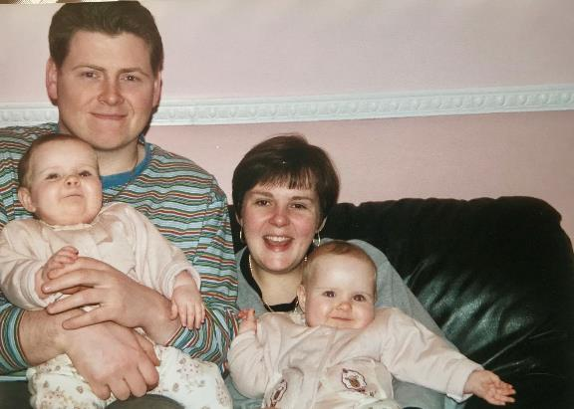
Parent Perspective
1. What did you know about Diabetes at the time and what do you wish you knew?
2. How challenging was it to have two Diabetic children?
Notes:
As we were so young at the time of diagnosis and the time period in which our lives were totally changed and restructured our account is some what of limited. However, our parents experienced first hand not only the change in our lives but also in theirs having 2 young children with diabetes diagnosed so close together.
We therefore believed it would be important today to offer them a chance to speak from their perspective and highlight how a diabetes diagnosis doesn’t just effect the patient but their entire network of support.
So we just have a short video to play now which poses 2 questions to our parents and captures their responses.
VIDEO
As you can see from our parents recollection it was challenging due to a lack of awareness and understanding of the condition at the time.

Slide 6
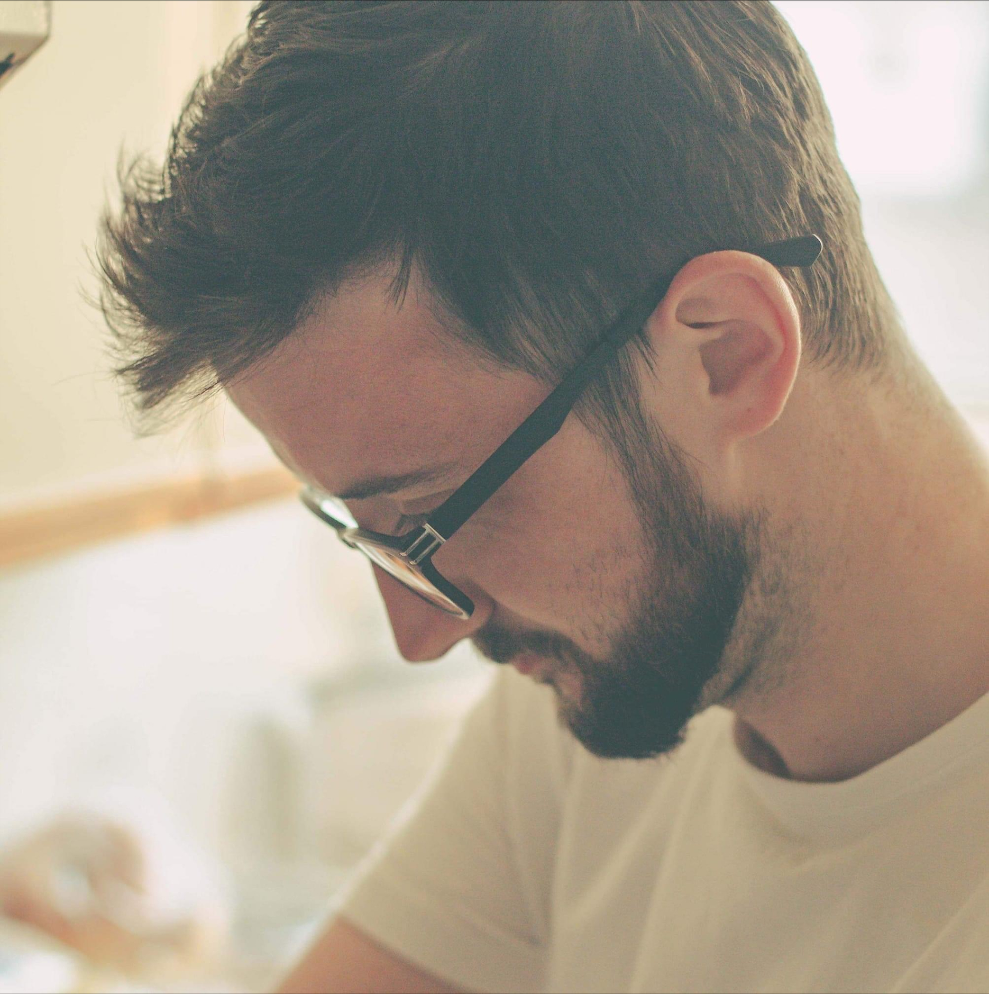
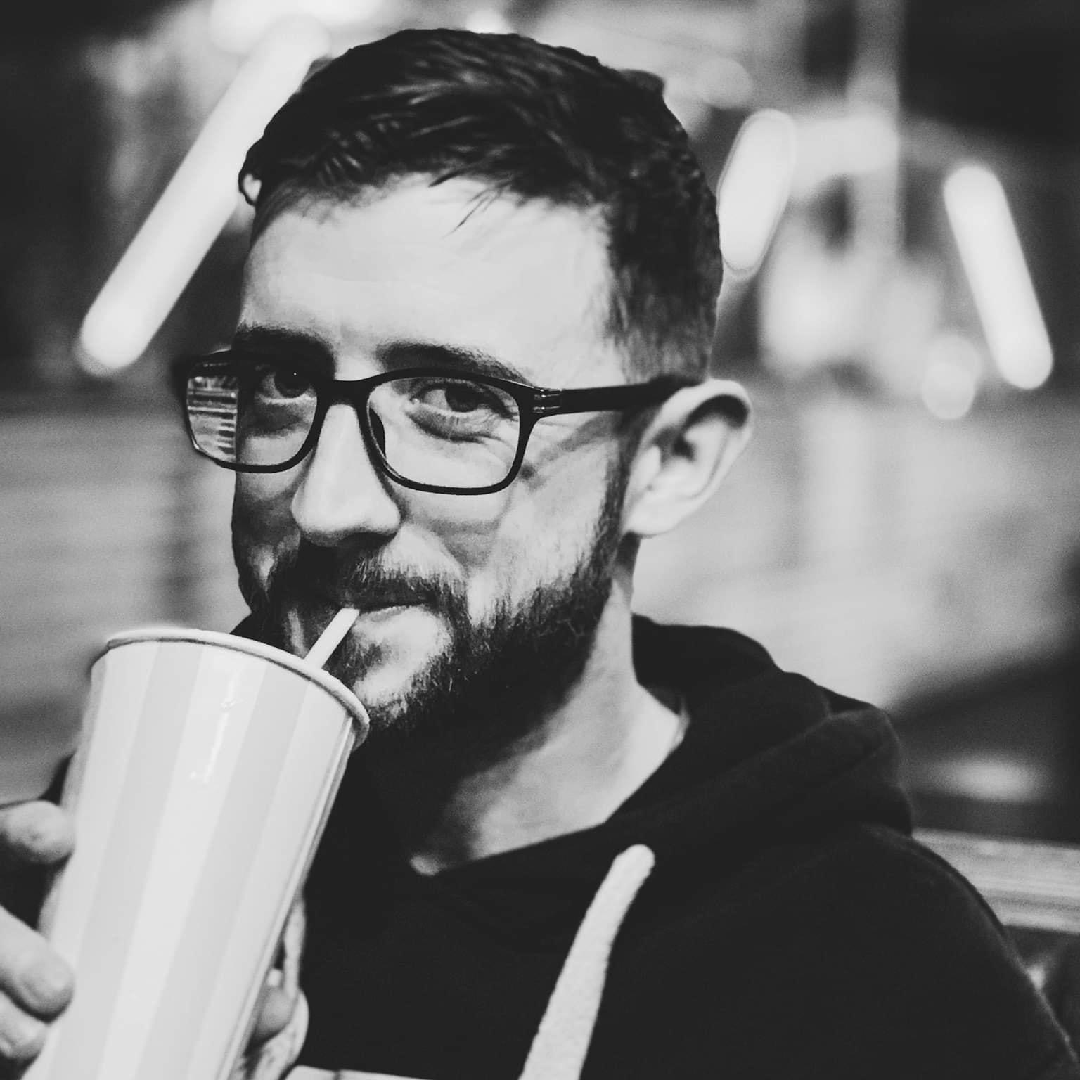
Adult Diagnosis
‘’ I never really understood how life changing something like Type 1 Diabetes really was. Finding out I had Diabetes while in my second year at University made everything difficult and affected just how well I did in my exams’’.
‘’Trying to balance looking after my Diabetes and doing my job at the same time is very hard. My job would sometimes take priority over my blood glucose.’’
‘’ I wish I knew more about Type 1 Diabetes prior to my diagnosis….’’
Notes:
The most common age for Type 1 Diabetes diagnosis is childhood. However that does not mean it is limited to childhood diagnosis. Often cases of Type 1 Diabetes are diagnosed in later adulthood as well.
Our dear friend Phil was diagnosed when he was 25 which of course had a massive impact on his life…
Phil said he never really understood how life changing something like diabetes really was. To this day it is still a constant struggle for him, he still finds after 10 years of diagnosis he is still finding new foods that have a big impact on his blood glucose. Phil said finding out he had type 1 Diabetes while in his second year of university made everything very difficult and affected how well he did in his exams, his social life and pressure of his family relations.
Phil previously found trying to balance looking after his Diabetes and doing his job at the same time to be very difficult and often his job would take priority over his blood glucose.
Phil emphasised to us that he wished he was more aware about Type 1 Diabetes prior to his diagnosis so he could have at least had a general understanding of the condition before being diagnosed himself.

Slide 7
So… What is it like living with Type 1 Diabetes?
?
?
Notes:
ROCHELLE
So what is it actually like living with Type 1 Diabetes? Its not something we felt we could explain in one sentence so the next slide gives you a visual representation of how we feel living with the condition is.

Slide 8
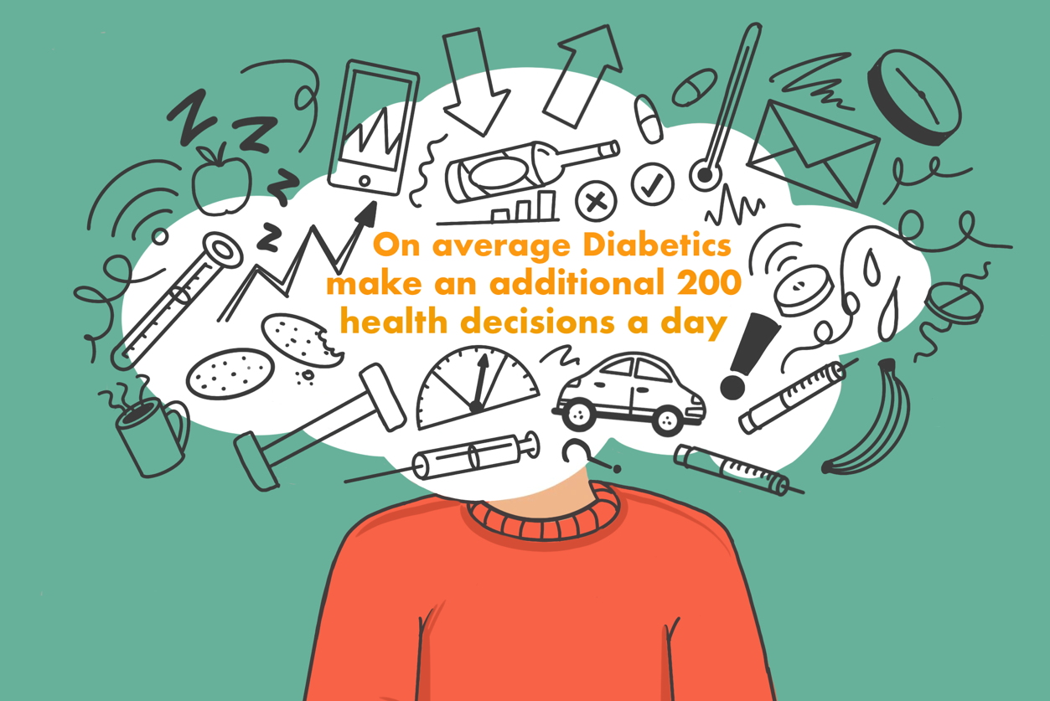
Notes:
ELISE
So this illustration to us captures the chaotic and by no means perfect management of diabetes and just how many blood-sugar-related variables can be in play at any given time. Plus, all these factors interact in complicated ways: “What happens to my blood glucose after five hours of sleep, a low-carb breakfast, lots of exercise, high stress, and a big cup of coffee?” It becomes difficult to react to and pinpoint a single variable when multiple variables can be acting at the same time.
When I first came across the quote on screen my initial reaction was that cant be right that is far too many decisions and I would know if I was making 200 decisions a day, however after hearing that quote I became more conscious of how many decisions I do actually make per day about my diabetes and how subconsciously they do become second nature as how we operate and so the illustration on screen is what's happening in my head but isn’t necessarily noticed by other people.
As we do become aware of our blood sugar variables and what does effect us we become an expert of not diabetes as whole but an expert of our own diabetes because what works for me may not work for another diabetic.
However we are not alone…

Slide 9
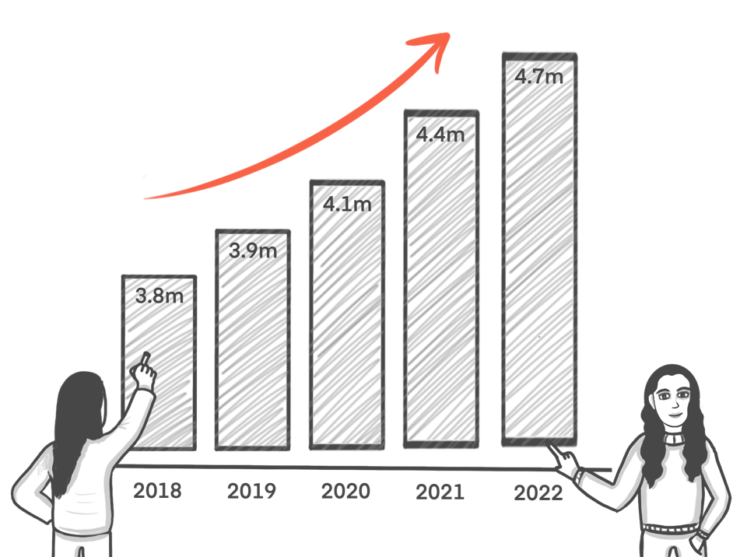
UK Diabetes Breakdown
4.7 Million
People in the UK have Diabetes
10%
Have Type 1 Diabetes
500,000
People in the UK with Type 1 Diabetes
2030
Predicted there will be 5.5 Million people living with Diabetes in the UK
Notes:
The number of Diabetics currently in the UK is only rising – R
I bet so many people in this room either know someone who is a Type 1 Diabetic or is Type 1 themselves
There is currently 4.7 Million people in the UK who have diabetes
10% of those are Type 1 so that’s nearly half a million people with Type 1 Diabetes in the UK
And this is predicted to rise to 5.5 million people with Diabetes in the UK by 2030, with an increase year on year already being demonstrated

Slide 10
Digital Advances in Diabetes Care
Notes:
ELISE
With the increase of those living with diabetes in the UK each year there is also a demand to continuously improve the delivery of diabetes care
So what digital advances in Diabetes care have we seen so far?

Slide 11
Continuous Glucose Monitoring (CGM)
Freestyle Libre
Or better known the Holy Grail of Diabetes.
Life Changing Benefits:
Reduction in painful manual testing
Predictive blood sugar levels
Informed decision making
Tailored clinical care
Peace of mind
‘’Wearing a CGM has given us a part of our life back we never knew we lost…’’
Notes:
So we have to talk about continuous glucose monitoring or better known CGM, or better know what I call it the holy grail of Diabetes – R
So lets state the obvious first, cgm’s have reduced our painful finger pricks to check our blood glucose, prior to receiving CGMs our fingertips were often very painful, bruised and sensitive.
For me a CGM gives me ultimate piece of mind, the predictive blood sugar and alarm system allows me to be able to drive with confidence knowing whether I need to wait to drive safely or I am good to go – so if you see me hanging around the car park after this you know I am having a Diabetic moment.
The alarm systems also wakes me up during the night if my blood sugar is dangerously low or high. Sleeping prior to getting a cgm was always for me quiet scary as I had to depend on my body waking me up if my blood sugar was not right which wasn’t always the case.
For me I feel as though I have more independence, I don’t feel restricted and tied to a blood testing machine I feel more empowered to not only monitor my blood glucose levels but to be able to do it in a discrete way which most people wouldn’t even notice I had taken a blood test as I swipe my phone under my arm like a contactless payment. My clinician at anytime can also go on and view my data meaning I am able to attend more virtual appointments than physical creating more convenience and independence.
For us receiving a CGM on NHS prescriptions back in 2019 will always be one of the best days of our life, it’s a day our quality of life changed forever.

Slide 12
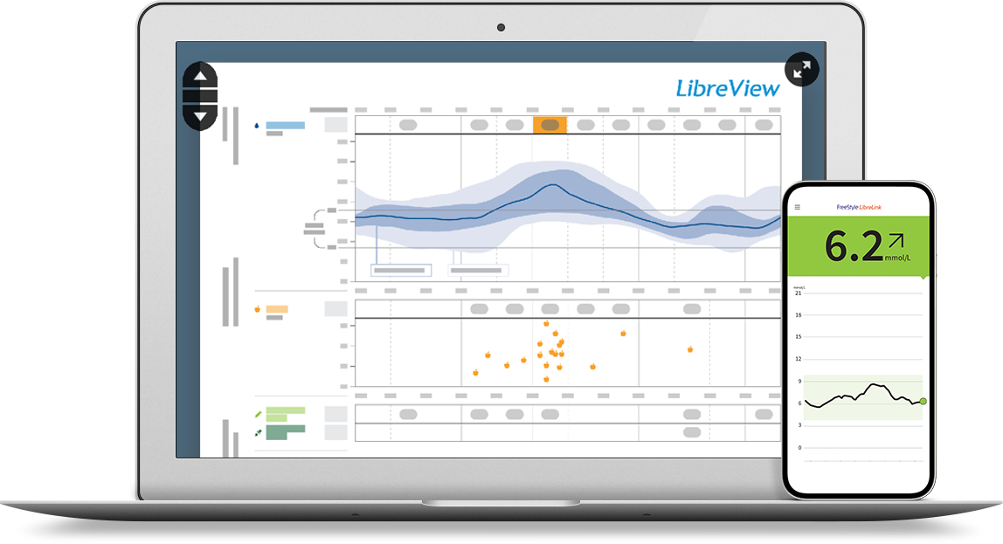
CGM Dashboard
Freestyle Libre
Or better known the Holy Grail of Diabetes.
View the same data and information that my clinician can:
Daily patterns
Time in target
Low glucose events
Average glucose
Daily graph
Sensor usage
Notes:
ELISE
A further benefit I want to go into is how the data we collect from our sensor is stored and used.
So the data is collected into a dashboard, the dashboard analyses the data to produce
Daily patterns
Time in target
Low glucose events
Average glucose
Daily graphs and sensor usage.
Now all this data is not only incredibly useful to my clinician but also me. What I appreciate about the dashboard is
Myself and my clinician view the exact same data
But it makes me feel as though they are viewing my data I have collected and not that I am viewing their data they’ve collected about me, I therefore feel centralised during our consultations and I am able to interpret the data and have a more informed conversation with them.
For example I may have noticed my blood glucose levels are higher mid morning than expected this could be the result of under injecting during my breakfast so I may need to adjust my insulin ratios. I can make that decision and act on that immediately
I don’t need to wait for my next consultation with my doctor for them to look at it because I can see the exact same data and trends in the dashboard and act on it.

Slide 13
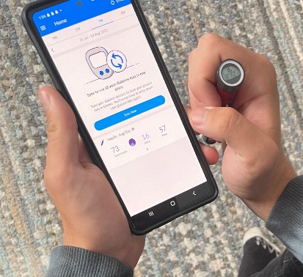
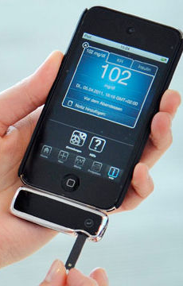
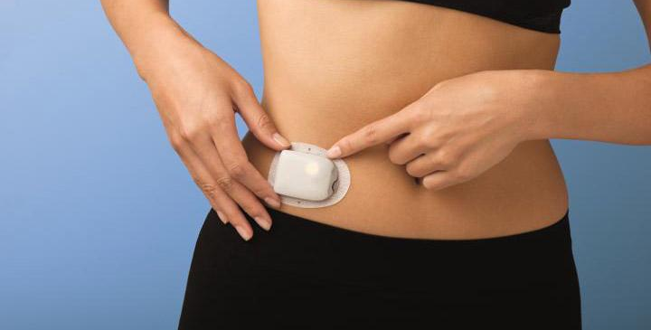
Device Advances
Size
A reduction in the size of wearable devices allows Diabetics to have more freedom in their everyday life.
Compatibility
Compatibility with everyday devices such as smart phones enables Diabetics to get up to date insight from the devices we wear.
Ease
Technological advances are allowing Diabetics to find comfort, independence and ease with managing our condition.
Notes:
CGMs are just 1 digital advance in Diabetes, there is so much more for us to look at
Lets talk about size, compatibility and ease
The size of our medical devices are only getting smaller. The omnipod (which is the bottom photo) is a 72 hour insulin delivery system it is what I would call a modern day insulin pump. For me I have always been interested in getting a pump, however I just cant get around the wires and tubes, its something I feel for me would not fit into my life properly. However the omnipod gives me ultimate confidence and hope that one day I will be om insulin delivery system.
Other digital advances include smart insulin pens. I cant begin to explain how passive we can get with injecting. The amount of times I have been out for food with friends and gone to inject when my friends have asked me why I am injecting twice, and I have no memory of even injecting the first time. A smart insulin pen logs when and how many units you have taken and is linked to an app on your phone. reducing the risk of a double inject – which I have done before.
And then of course we have phone compatibility – There are glucose monitors that can be plugged into your phone and record the data within an app and this is just the tip of the iceberg for apps around diabetes.

Slide 14
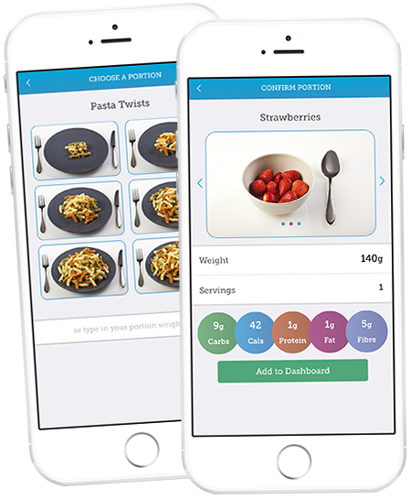
Apps
Thoughtful Eating
As a Diabetic carb counting can be overwhelming. Apps such as GoMeals and Carbs+Cals makes managing what we eat easier and less time consuming.
Data Trends
Digital advances allow apps to identify trends and pin point issue areas that could often be missed prior.
Community
Apps allow Diabetics to use forums and build open conversations around our condition, building a community.
Notes:
As a diabetic card counting and carb ratios directly impact our blood glucose levels
As we eat we should be calculating the correct grams of carbs in everything we eat to give corrective doses
This can become difficult when eating out and trying new foods as there is a level of uncertainty which often leads to anxiety around these experiences
Apps such as Go Meals allows us to search popular restaurants and breaks down their dishes showing the total grams of carbs for their menu items. Not only does this make our life easier it reduces levels of anxiety and uncertainty which can over shadow these social experiences.
The cals and carbs app works as a google of carbohydrate I would say in you can search ]ingredients and dishes to give you guidance on how many grams of carbs your eating, this can be helpful for home cooked meals or new recipes.
These community based apps aid in delivering a support network and guidance.

Slide 15
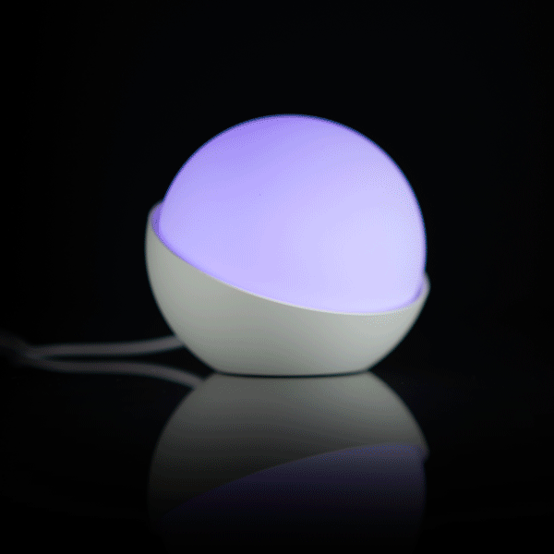
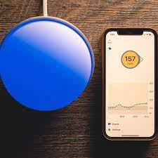
Glowcose
Glowcose is a colour changing light that changes colour with CGM readings.
Reduce the stress of constantly checking your phone for you or your loved one. No need to interrupt your sleep, work, or daily activities. A quick glance lets you know where you're heading.
Notes:
Next we have the Glowcose
The Glowcose light is a colour changing light. The colours change dependent on your CGM reading of blood glucose level.
Going back to what our parents discussed prior on how hard it was for them having to check our blood sugar every 4 hours in the night, with a Glowcose having a visual light that you can asses whether your child's blood sugar is in range or not is life changing not only for patients but for parents and carers of children with Type 1 Diabetes.
Even as an adult, having a light you can open your eyes to in the night rather than grabbing your phone and scanning, again is a big improvement in our quality of life and it would look quiet nice on your desk when working from home.

Slide 16
Its not all perfect…
Personal Issues
Clinical Issues
Data overload
Faulty sensors
Knowing the regulations
Data overload
Funding
Technical resistance
System outage
Closed loop hacking
Faulty data
Insufficient data
Missed appointments
Desensitised
Delay in data received
Painful application area
Notes:
But its not all perfect, as we are all aware of course digital can have some issues. -E
One of the issues I encounter is desensitisation to the alarms of the CGM sensors. So the alarms are loud and when I say loud they used to give me a fright and I tried to turn them down when I first got the sensor which is not clinically advised at all. Now however I have become so used to the sound of the alarms that I am in a certain way desensitised to them so I can sleep through several of them before I wake up which is dangerous. I would like to see a feature in which you can alternate the sound of the alarms.
Another issue I experience with the sensors I use is the delay in data, so the sensors we use are approximately 8 minutes behind our actual blood glucose readings in our body, now for me my blood sugars can unfortunately drop dangerously fast meaning by the time my alarm notifies me I may already be quite low. I am being changed to a different manufacturer whose sensors do give live data to combat this issue because that’s what my diabetes requires.
And some of my personal issues include, complete data overload, sometimes its hard to know what data to look at as a patient and that can be overwhelming. I also often find I am having to play catchup with digital regulations especially around wearable devices and the DVLA. Where are CGMs regulated on the body and what might void my insurance unknowingly
My biggest issue has been faulty sensors and application of sensors. I have had a few that get stuck to my arm because the retractable needle has not worked and does not retract and a few weeks ago I think I gave Elise abit of a scare when we were in the office and I had changed my sensor and hit a nerve in the back of my arm and came out the bathroom pouring of blood – which then made the sensor completely uncalibrated so I had to put a new one on a few hours later – R
But its not only what we find as issues, we have to look at it from a clinical perspective as well…
CGM’s are great at recording every single piece of data about a patient but this can often cause more issues than help solve them. Often clinicians can be faced with complete data overload, faulty data and insufficient data.
Hearing some clinicians speak on data overload we understand how frustrating that can be. My doctor doesn’t need to know my blood sugar was low yesterday lunchtime for 10 minutes. But they do need to know my blood sugar is always low around 11am and we need to identify why.
Along with technical resistance from patients, lack of funding and missed appointments its absolutely by no means smooth sailing - E
So of course Digital advances have issues, but it doesn’t mean its been any less life changing for so many people, us included…

Slide 17
Where is Diabetes care heading?
Notes:
So where is Diabetes care heading?
We have seen 20 years of digital advances in Diabetes care where do we think the next 20 years are going to take us?

Slide 18
CGM
INSULIN PUMP
Closed Loop Systems – ‘The Artificial Pancreas’
Notes:
So Closed Loop Systems – or the artificial pancreas
A relatively new system in Diabetes care, still in early stages with NHS availability. The creation of CGM has made it possible for our insulin pumps to talk to our cgms and automatically give us the insulin we need dependent on our blood sugar reading from our CGM therefore gaining its name as the artificial pancreas and closed loop system due to its calculated insulin delivery
This could be revolutionary for diabetics, especially those who struggle to manage their diabetes, for young children or for those who suffer from other health complications as it creates control and management. With a level of reassurance that the correct amount of insulin is being given at the correct time and it takes away the pressure on the individual.

Slide 19
HbA1c Monitoring
What is a HbA1c test?
A HbA1c blood test shows your average blood glucose (sugar) levels for the last two to three months. If you have diabetes, an ideal HbA1c level is 48mmol/mol (6.5%) or below.
Advances in technology including CGM make it possible for HbA1c prediction.
But wouldn’t it be beneficial if our CGM’s could actually tell us what our HbA1c is rather than predict?
Notes:
Next we have HbA1c testing, if your familiar with Type 1 Diabetes you will know that HbA1c in simple terms is how your doctor overall see’s how much glucose is attached to your hemoglobin and therefore indicates how well you have looked after your Diabetes for the last 3 months.
Our doctors often check ours by performing blood tests and analyzing our samples.
You may have noticed throughout the presentation some small version of us happily taking you through. As you can see as soon as we have brought up blood tests the poor little versions of us are slightly more terrified. We wish it was just the little drawing version of us that have issues with blood tests but its not, it’s the real big versions as well. On average we get our bloods done about 6 times a year, which over 20 years is about 120 blood tests in our diabetic lifetime. Every single time without fail we will have to be layed down and given water. Often when we get to our Diabetes center in Newcastle, walk happily around the corner and hear the entire Diabetes team sigh because they know they have two difficult blood tests ahead of them.
Advances in technology have given us the option to view a predicted HbA1c on our CGM devices. However, wouldn’t it be another huge digital advance if our CGMs could actually tell us what our HbA1c is rather than just predict? Meaning for us less blood tests, less hospital trips and more self ownership on our HbA1c

Slide 20
Care
Digital advances in Diabetes have completely changed the quality of care we provide to our patients.
Data
With more data available than ever, Diabetes care is tailored to each individual.
Remote
Being remotely able to view a patients data, identify trends and flag issues.
Clinical Benefits
Next Steps
Further digital advances can only add to the clinical benefits of Diabetes care.
Notes:
Digital Advances in Diabetes care will of course see mass clinical benefits as well.
I recently attended the Digital Summer School and had such a fantastic discussion with a Nurse who firsthand has seen the clinical benefits of things like cgms when caring for patients on wards.
Prior to cgms the nurses would need to wake patients for fingerpicks during the day and night. Now due to the cgms and patients' permission nurses can simply scan a patients arm without disrupting their much-needed rest with the patients mobile device or scanner.
But wouldn't it be fantastic if when a patient with Type 1 Diabetes checked into hospital, we could automatically scan their sensor to central hub and track their glucose levels remotely, with multiple patients on one system. Not only giving patients rest time but also saving clinical time as well.
So just as a reference to how far technology has come from when we were first diagnosed we would record our readings down in paper books and that’s what the clinicians would look at and try to produce everything this software does automatically, these advances have taken strain off clinicians and allows them to see more patients.

Slide 21
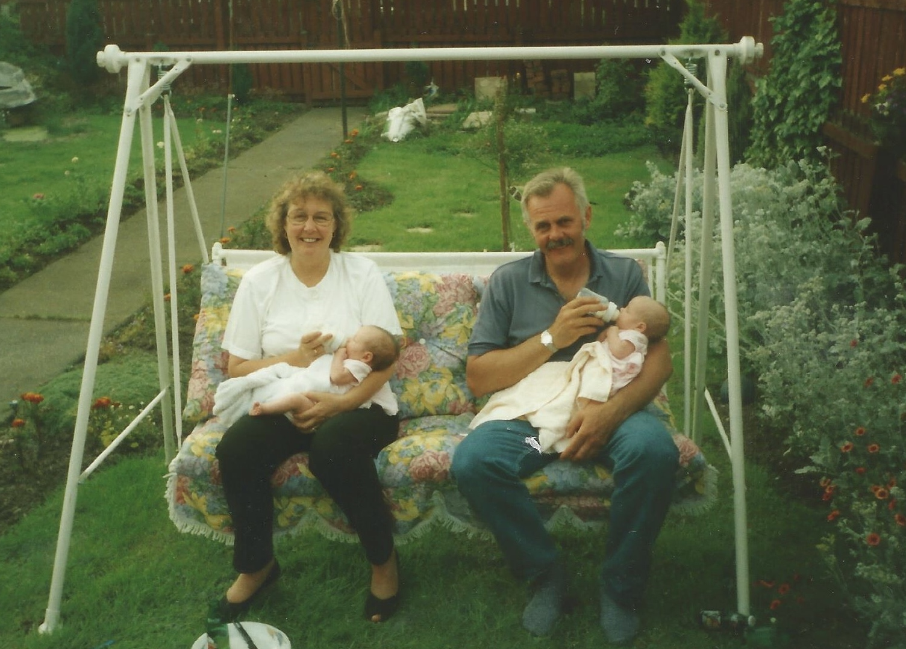
‘Not in my lifetime, but in theirs…’
2005
A set of concerned Grandparents with two young Diabetic grandchildren ask a doctor in an elevator a simple question.
‘Will there ever be a cure for Type 1 Diabetes?’
The Doctor pausing for thought (or dramatic effect).
‘Not in my lifetime, but in theirs’
Notes:
ROCHELLE SLIDE
And of course we have to talk about a cure for Diabetes. So lets start with a story
So a set of concerned grandparents with two young newly diagnosed Type 1 Diabetic grandchildren asked a doctor in a lift at a Diabetes hospital.
Will there ever be a cure for Type 1 Diabetes?
The Doctor pausing for though, or dramatic effect…. Answered
Not in my lifetime but in theirs…
And I strongly believe that, the advances in digital diabetes care has been so life changing for us and can only get better. The term cure I think we still don’t know what that means, is it the closed loop artificial pancreas, is it pancreas transplants, will there be digital pancreas’s in decades to come we can control from an app? We don’t know, but I do know I have a lot of hope I wont be Diabetic forever.

Slide 22
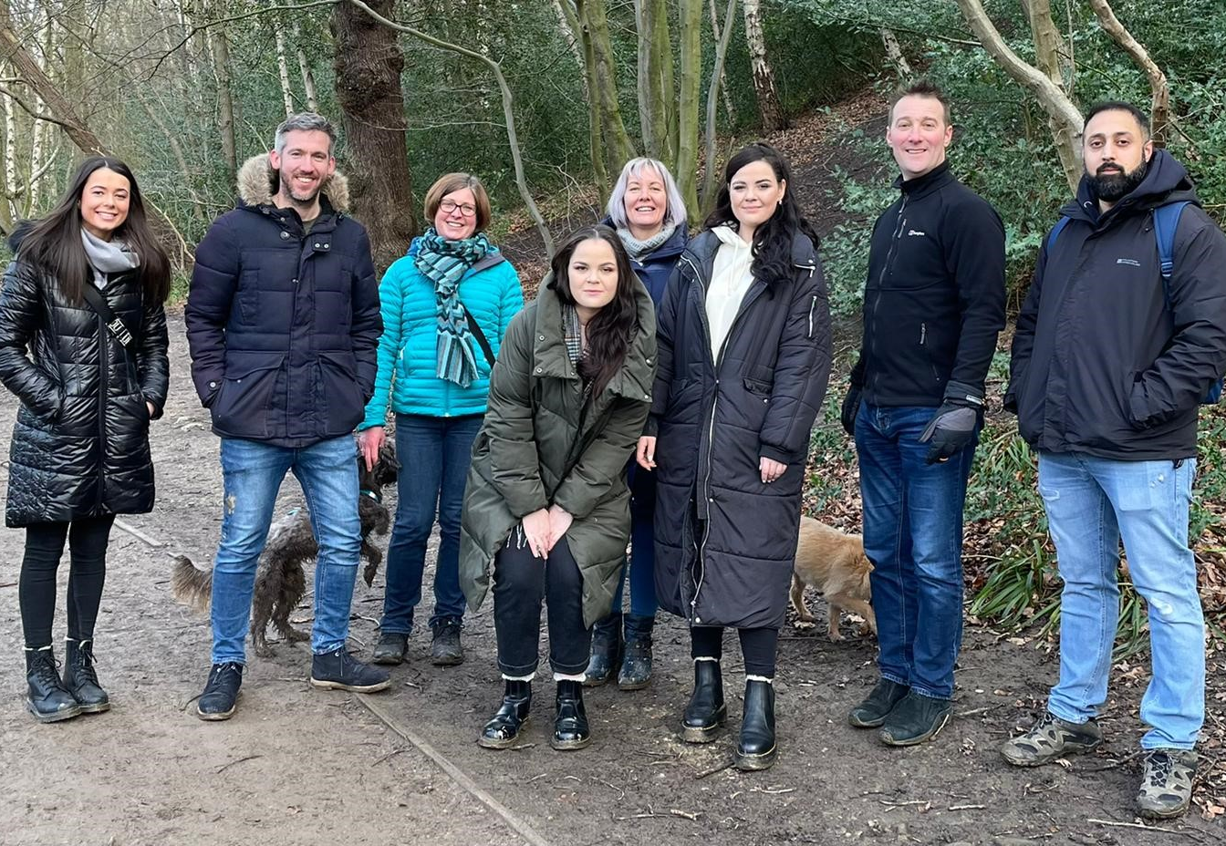
Diabetes inspired our career
We know first hand how much Digital advances within healthcare can change a patients quality of life.
Having experienced these benefits we wanted to pursue a career in which we could contribute to the implementation and utilisation of technology within healthcare to improve delivery of care and quality of life, as we have experienced.
Notes:
We know first hand how much Digital advances within healthcare can change a patients quality of life.
Having experienced these benefits we wanted to pursue a career in which we could contribute to the implementation and utilisation of technology within healthcare to improve delivery of care and independence.
We have been so fortunate in the care we have received and how much our teams have embraced technology we want to create these opportunities for others.

Slide 23
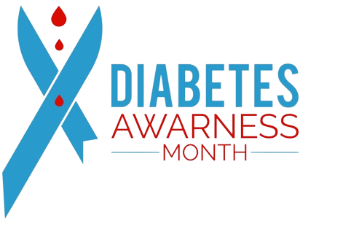
Thank you for listening.
Any Questions?
NOVEMBER
14TH NOVEMBER WORLD DIABETES DAY
Notes:
Thank you for listening does anyone have any questions.

Slide 24
Contact Information
Rochelle Featherstone
Elise Featherstone
Rochelle Featherstone
elise.featherstone@nhs.net
Twitter: @EliseFeatherst1
Linkedin: Elise Featherstone
rochelle.featherstone@nhs.net
Twitter: @RochelleFeath
Linkedin: Rochelle Featherstone
Notes:
Doesn’t need Notes

