Slide 1
‘Outside Looking In’ – Jon Hoeksma, CEO Digital Health

Slide 2
A high level view of NHS and digitisation as at November 2022
I’m the founder Digital Health Intelligence
- publisher of Digital Health News
- organiser of Rewired
- organiser Summer Schools
- convene CCIO/CIO/CNIO Networks
Previously founder/director E-Health Insider 2000-2014
Freelance journalist specialising in technology and health – Reuters, The Guardian, BMJ, FT, Times, Doctor, Pulse
NHS Management Trainee

Slide 3
Politics and Economy key to NHS prospects: A World turned upside down

Slide 4
UK and NHS face unprecedented pressures – return to 1970s
UK “Sick man of Europe” again GDP not recovered to pre-pandemic
Poor health of UK economy since 2008 financial crisis cruelly exposed over-reliance of UK economy on services alone.
Followed by self-harm of Brexit – low GDP growth and recession.
A second decade of austerity
Hostile political environment to NHS –political instability
Sharp widening of income inequality - society far more divided
UK has a lower GDP in comparison with peers

Slide 5
Conservative press calling for NHS cuts
The Spectator
The Telegraph

Slide 6
Through the looking glass: myths and magical thinking about the NHS' series, Nuffield Trust Myth #1: “We already spend too much on health – and despite this our outcomes are poor”
Poor outcomes: not just about money
The poor outcomes of the NHS in several key areas are well documented. From heart attack, to stroke, to cancer, mortality rates are higher than the average among western European and Anglosphere countries. But the reasons behind these poor outcomes are complex and include our high levels of inequality, our cultural attitude to seeking health care, and the underlying health of the population. - Nigel Edwards, CEO Nuffield Trust

Slide 7
How does the NHS compare internationally?
Mirror, Mirror 2021: Reflecting Poorly Commonwealth Fund

Slide 8
Mirror, Mirror 2021: Reflecting Poorly Commonwealth Fund
“No two nations are alike when it comes to health care. Over time, each country has settled on a unique mix of policies, service delivery systems, and financing models that work within its resource constraints. Even among high-income nations that have the option to spend more on health care, approaches often vary substantially.”
“With the COVID-19 pandemic imposing an unprecedented stress test on the health care and public health systems of all nations.”

Slide 10
Conclusions of Commonwealth Fund Int report Four features distinguish top performing countries from the United States:
1) they provide for universal coverage and remove cost barriers;
2) they invest in primary care systems to ensure that high-value services are equitably available in all communities to all people;
3) they reduce administrative burdens that divert time, efforts, and spending from health improvement efforts;
4) they invest in social services, especially for children and working-age adults.

Slide 11
How can digital and data best help the NHS next?

Slide 12
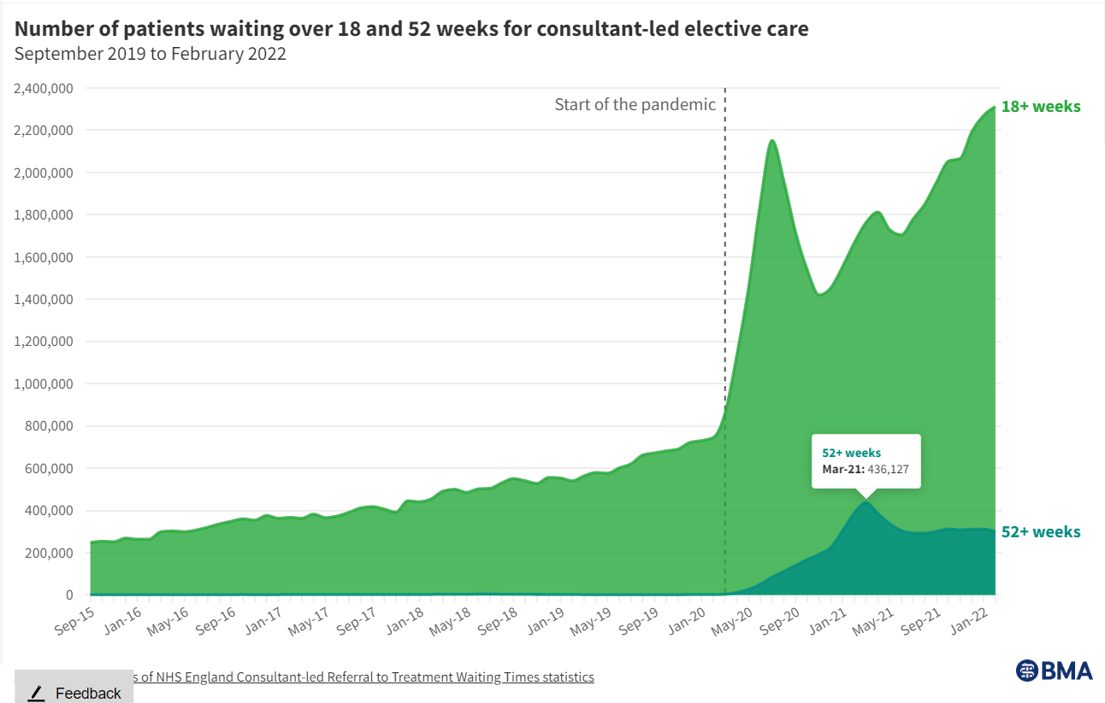
How to face today’s most pressing challenges in health using digital and data?
3 big challenges to begin with:
Elective recovery - 7m on waiting lists
Financial recovery
Levelling-up and equity

Slide 13
First, forget about targets… Everyone else will
90% of trusts to have EPR by Dec 2023
Going back to 1996 there have been multiple NHS IT strategies, which all have the goal of having EPRs or similar within 2-5 years.
While progress has been made each time – C. 75-80% of trusts have some sort of EPR – the targets are always, always missed. So will these.
We’ve had 3 Health Secretaries since Sajid Javid anyway (Steve Barclay, Theresa Coffey and Steve Barclay)
The key point to remember is that we are on a rising tide of digital and data and the tide is now in full flow…

Slide 14
Where have we got to on NHS digitisation journey?
Provider digitisation continues to dominate – largely because this is where the big budgets are
But the majority of trusts now have EPRs of increasing sophistication and vast amounts of data, growing use of shared care records
Increased focus on convergence and standardisation – again mostly provider focused
Advent of ICSs/ICBs remains at an early stage
Very limited money
Digital and data gone mainstream – now everyone’s job
Huge upheaval in NHS E/NHSD C 40% cuts

Slide 15
Does ICS/ICB agenda offer the opportunity to shift the focus on digital and data?
Can we move beyond provider digitization? Necessary but not sufficient
Can we move to meaningful population health and person-centred health?
In this context is EPR convergence a blessing or a distraction?
What should be the priorities for ICS/ICBs?
What should leveling-up mean?

Slide 16
Levelling-up and convergence - issues
Lack of Money - GSST and Kings £450m on Epic EPR
These kinds of deals are in some ways akin to digital PFI – digitally locking NHS into patterns of service provision
Just not an option to go this route for all
Also question of whether the whole model outdated - not ICS-wide - focus largely on hospital sector.
Primary care not progressed in 20 years due to inept policy -> monopoly market
In many parts of the NHS there is no obvious EPR to standardise on
EPR is the beginning not the end of digital transformation
What comes next? Where’s the vision beyond EPR

Slide 17
Digital lessons of Covid-19 response?
That, in the right circumstances, the NHS is capable of successfully achieving very large-scale digital shifts
Data quality needs far more attention – vulnerable patient lists
That across all demographic groups digital services can work
That such shifts require the removal of multiple layers of bureaucracy
Suppliers are key partners
They require very clear top-cover that it is ok to take risks, to move quickly and solve problems as you go
That IG should not equal ‘no’.

Slide 18
Wider digital agenda in health
Interoperability – not investing nearly enough attention or resource
With far more EPR plumbing in place we have a tsunami of data
Federated Data Platform – NHS England’s data baby £300m Palantir?
Trusted Research Environments – focus of the Goldacre Review
Wider world of consumer-centred digital health: Babylon, Livi etc etc proven out service but not always business models
Cyber security – increased digitisation means increased vulnerability
Skills – estimated to be skills gap of 40-50K

Slide 19
Organisational change, lots of it…
Health and Social Care Act – Royal Assent in April
Merger of NHS Digital, NHSX, NHS England and Improvement = NHS DIXIE
No longer a separation between policy and implementation and no separate data agency
Trust - Care.data (axed in 2016) and GPDPR (suspended in 2021) Federated Data Platform and Palantir (next…?)
Abolition of HEE and other agencies – skills gap
Creation of ICSs and ICBs in July 2022 (they are brand new)
PCNs, hospital groups, more mergers

Slide 20
Delivery and benefits
All of this reconfiguration is very distracting and has often has very little to do with delivery and benefits (or digital transformation)
The risk is that massive opportunity cost of such change and disruption last seen in the 2010 Health Act
The key point remains that digital is an enabler of transformation not the end in itself and the key challenge remains one of ‘adaptive change’.
As Dr Bob Wachter noted in his 2016 review of NHS IT the act of digitisation ‘changes the nature of the work itself’
The productivity benefits continue to lag - as per experience in many industries.

Slide 21
What are the strategic opportunities for digital and data in health?
Freeing clinical time to care
Improving productivity
Using data to gain actionable clinical insight
Addressing variations in care and accelerating adoption of evidence-based care
Population health management and person-centred wellness models
Shifting services to digital channels while decommissioning some bricks and mortar

Slide 22
Top 6 digital disruptors for the NHS

Slide 23
1 - AI and Data
AI, ML, big data will prove out (that beneath all the froth and hype these will emerge as the key trend in health IT to manage complexity of data and processes).
Automating and helping make sense of the sheer mass of data now available and on the way will be key. Particularly when intelligently embedded into clinical workflows.

Slide 24
2 - Open Platforms and interoperability
Open platforms and architectures that truly separate data from application layer and common shared services have to (eventually) become the way ahead. The are needed to better reflect today’s models of care delivery.
Much good work has been done by bodies such as HL7 and FHIR but ultimately policies, laws and procurement standards with real teeth are all needed. US 21st Century Cures Act, 2016, encourages reporting of inf blocking
Today, we clearly don’t value interoperability enough as we continue to buy from data robber barons and blockers.

Slide 25
3 - Environmental sustainability
How to make our IT environmentally sustainable. Increasing use of IT requires increasing amounts of technology that gets replaced every 3-5 years and consumes energy.
In part this is about security and resilience. Increase energy and unrest around the world means that there are increasing security threats, including nation state players.
And the more we depend on informatics infrastructure, the less resilient we become (eg if there are rolling 3 hour power cuts, then primary care will be wiped out during those power cuts because we are part of the community we serve.)

Slide 26
4 – Population health management
Routinely using data insights to target timely interventions before people become ill and effectively support people with long-term conditions to live healthier lives, improve outcomes and avoid hospitalisation, should be the digital priority for every ICB. Yet few are doing it.
One ICS vet says that just 20 standard well known interventions would make all the difference. Not happening yet
Then moving on to personalised health coaching and engagement – again just scratching the surface.

Slide 27
5 – Voice
Getting structured data recorded into patient notes remains a fundamental stumbling block in digitising healthcare. The potential to capture a contemporaneous, structured, coded record from an in-person or digital consultation (live or asynchronous) could prove a missing piece of jigsaw.
Similarly, the potential of Alexa-style intelligent health agents to deliver automated remote home monitoring and care support has barely begun.

Slide 28
6 - Cyber security across health supply chain
Disruptive in every way you don’t want. The high level of digitisation of health means it is vulnerable as never before, and a target of choice. In part three months have seen Advanced attack and Medibank in Australia.
The NHS has to have visibility across its supply chain as well as securing own networks, staff and devices.
Imagine if 12 teaching trusts had been locked out of their EPR systems for three months
These are the opening salvos

Slide 29
7 – Next generation of NHS digital leaders
Watch out today’s leaders. There is a generation of disruptive, younger and impatient digital leaders from many different backgrounds – nurses, midwives, phamacists, AHPs, junior doctors, data scientists, developers, UX designers, start-up founders - starting to emerge who want to make change happen now.
In part driven by initiatives like NHS Digital Academy, but also by being generation Xers who have never known a pre-digital society or NHS. They are unlikely to be impressed by tales of ‘how we used to use paper for that’

Slide 30
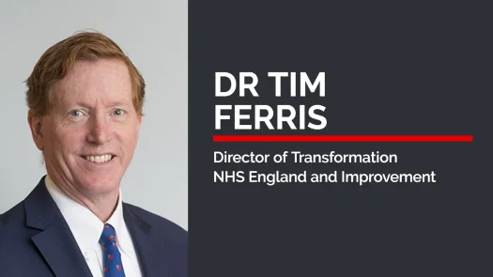
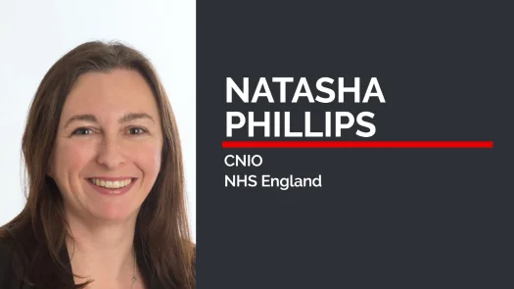
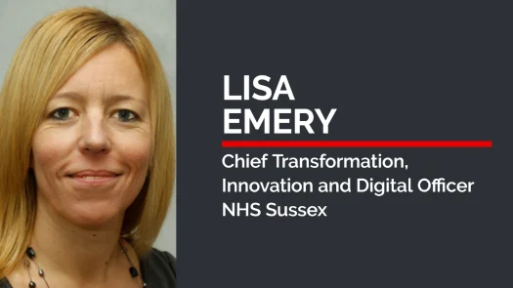
The best of digital, data, NHS IT and innovation under one roof.
CPD certified content
7 stages incl. Policy, Transformation, Integrated Care, Nursing, AI/analytics
Live Pitchfest final
1,200+ already registered
Business Design Centre, London

Slide 31
Thank you
Questions
jon@digitalhealth
@digitalhealth2
07771 657983

