Slide 1
Clinical Informatics - so what?
10th November 2022
Senior Responsible Officer - James Thomas
Lead Chief Information Officer - Paul Jones
Chief Clinical Information Officers - Justin Tuggey
Programme Lead - Dawn Greaves

Slide 2
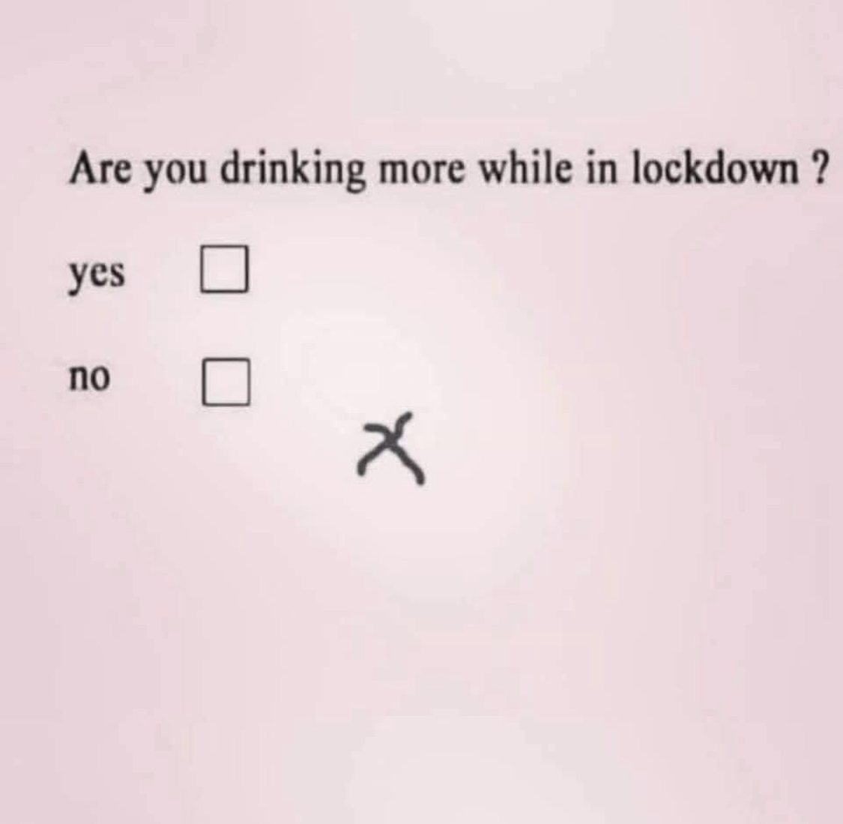
What good can look like

Slide 3
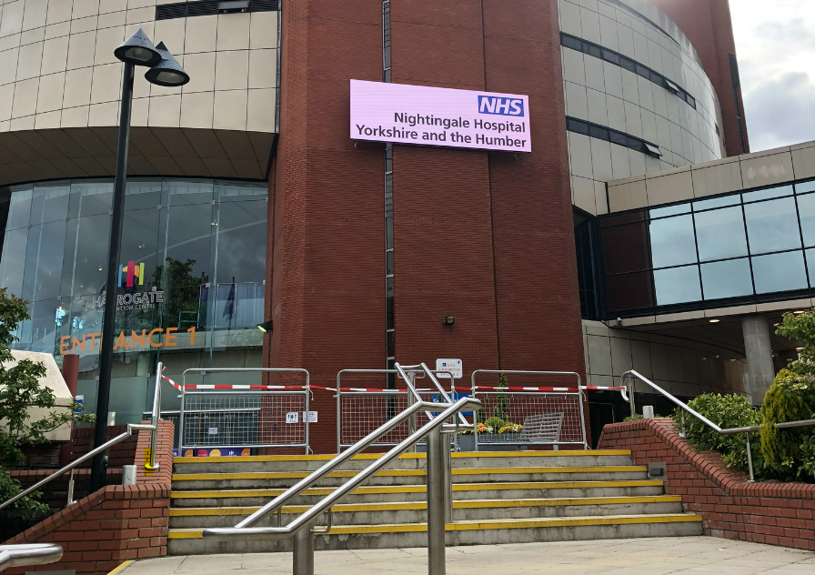

Slide 4
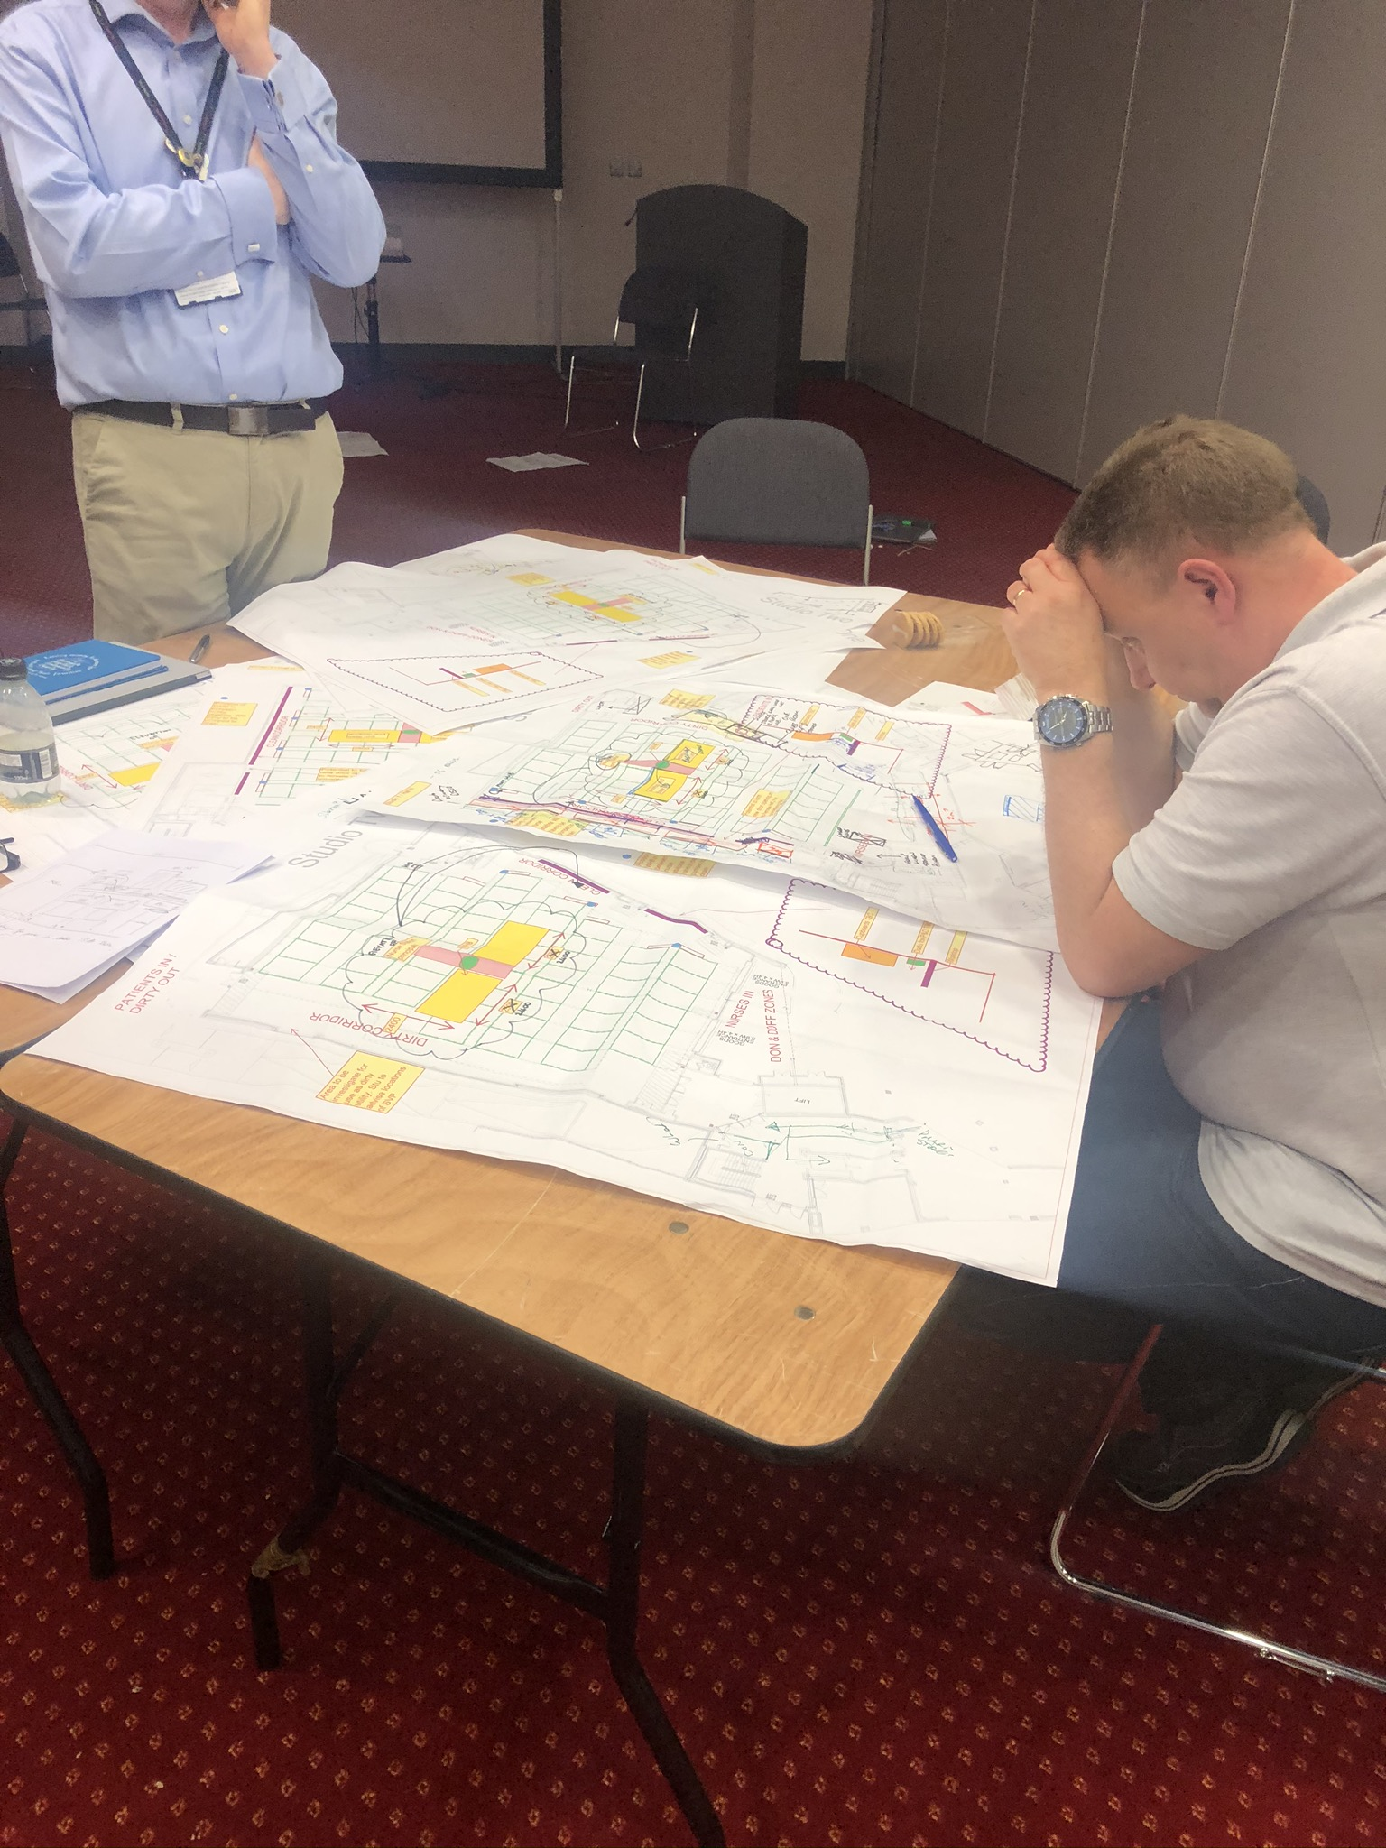
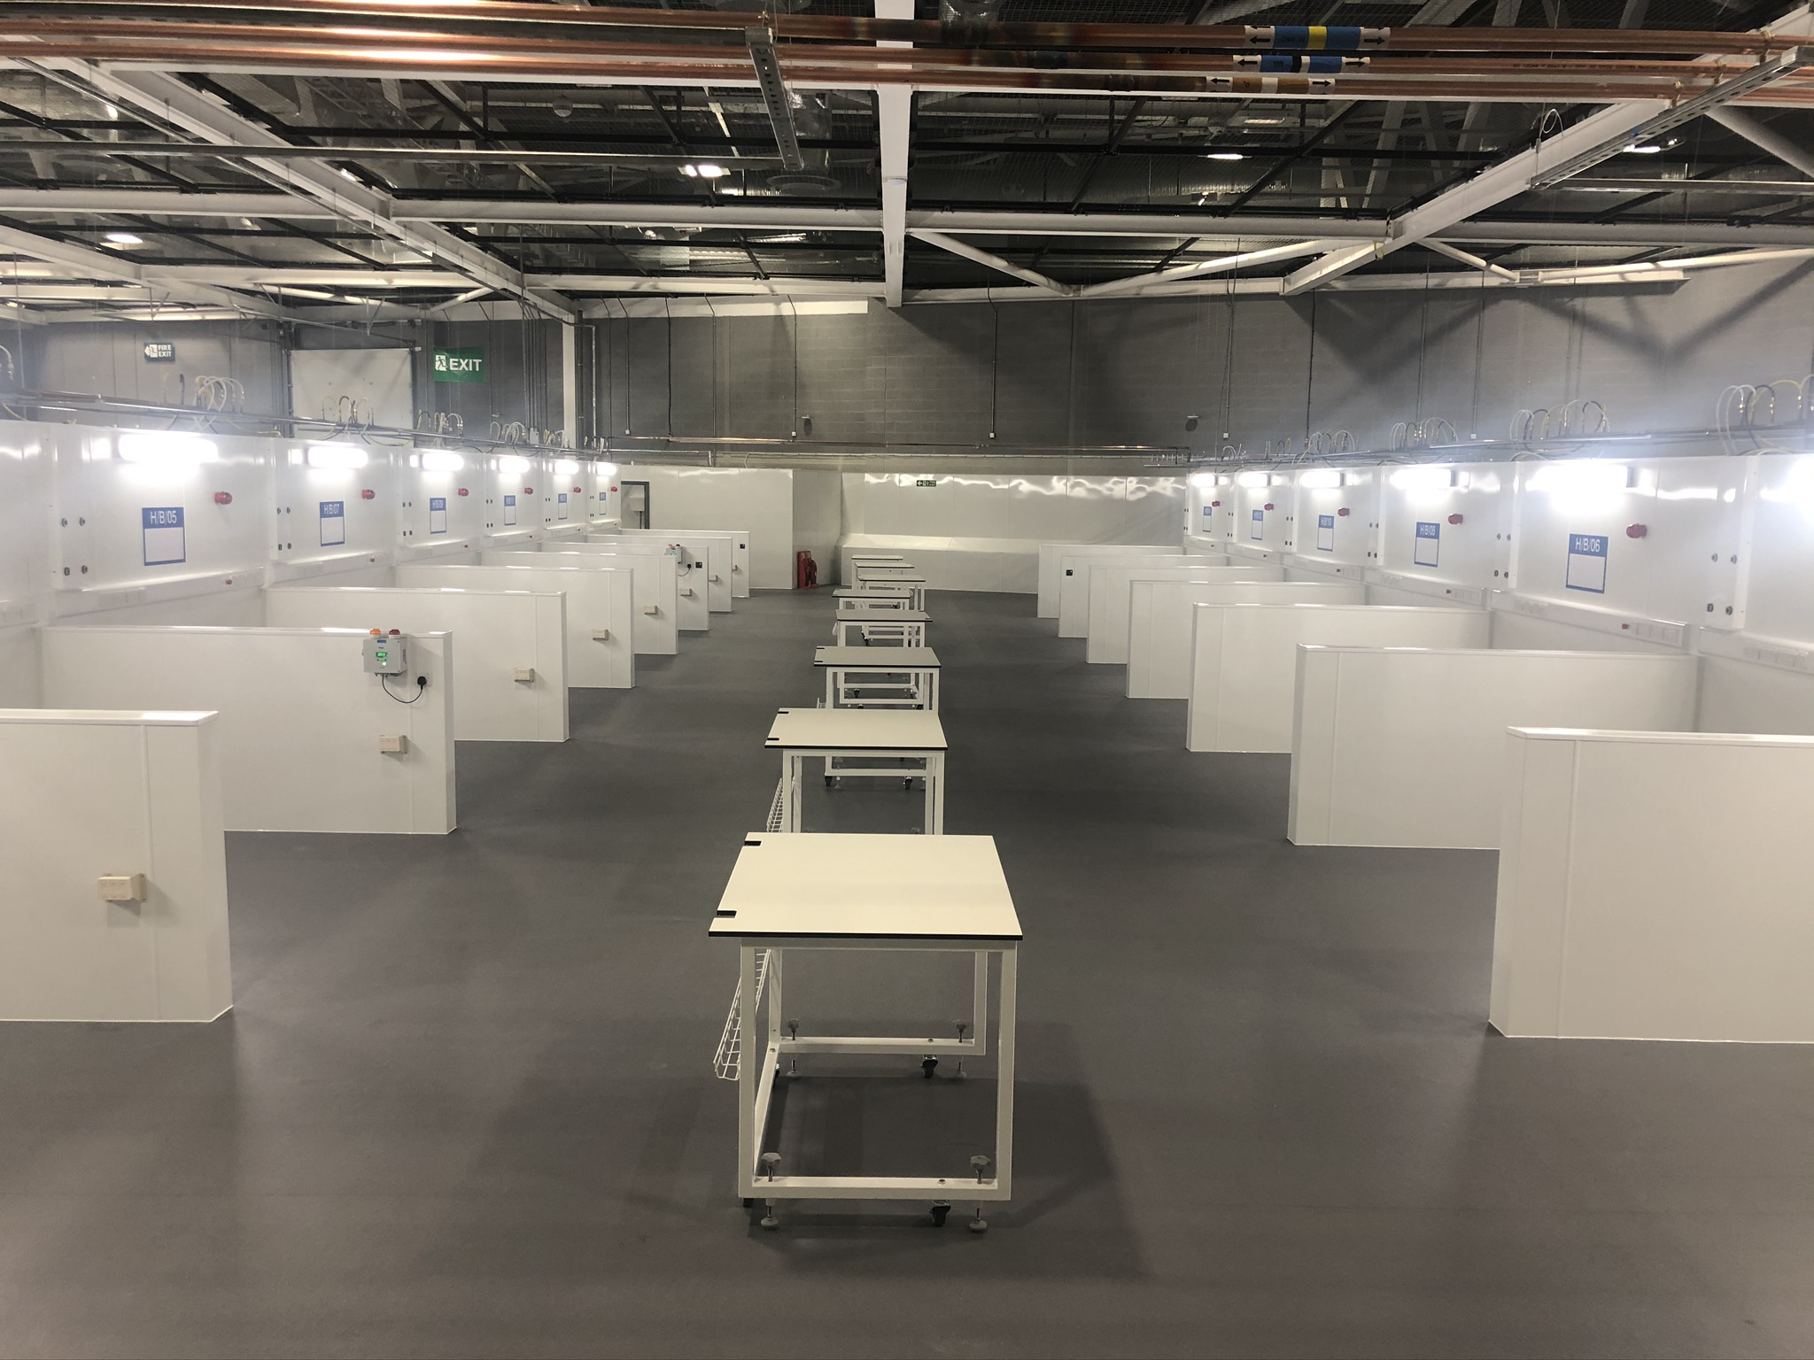
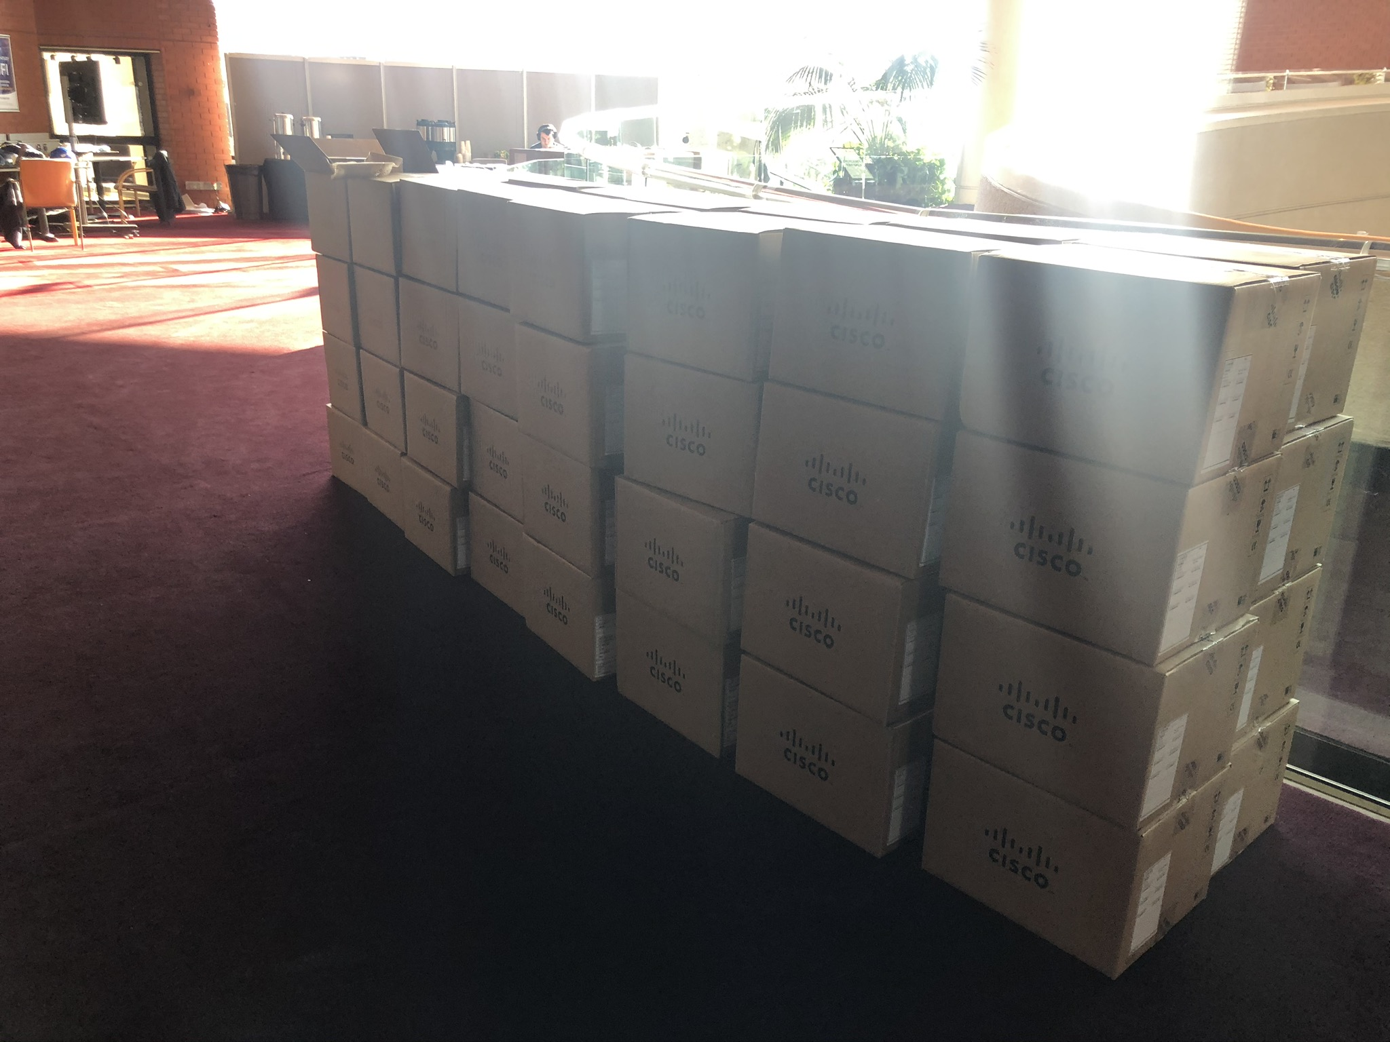
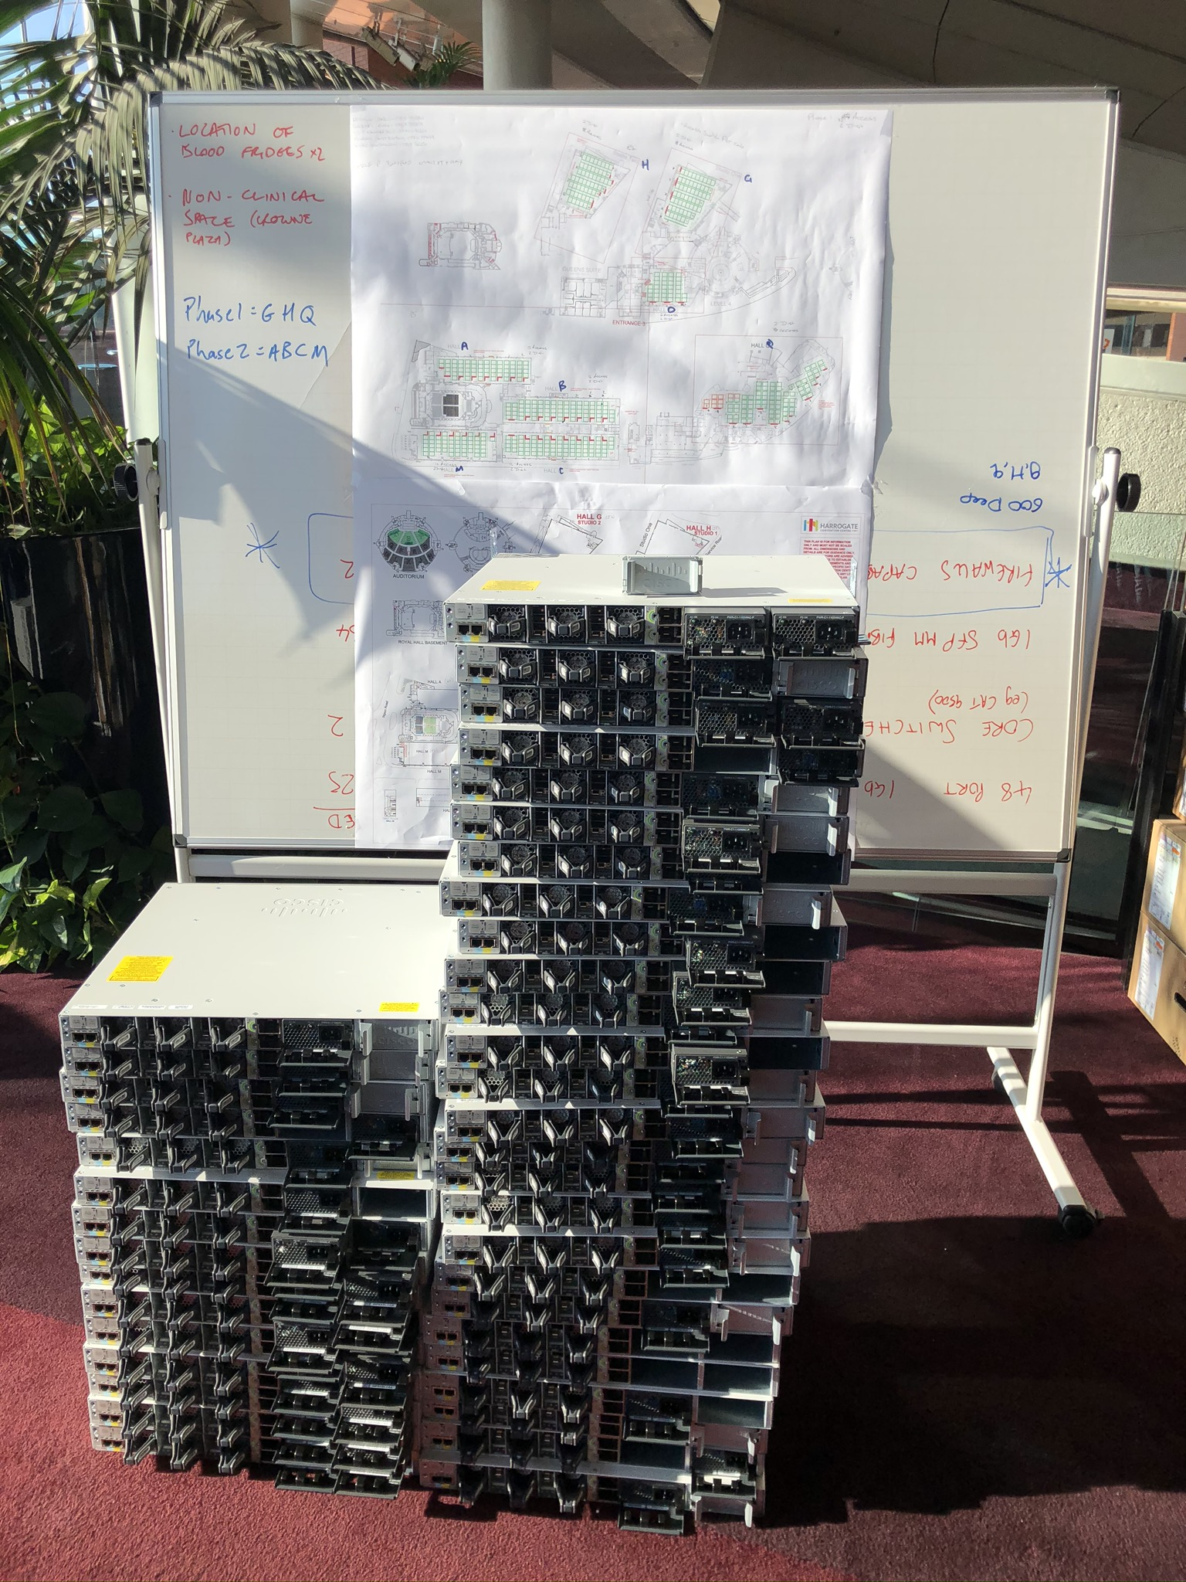
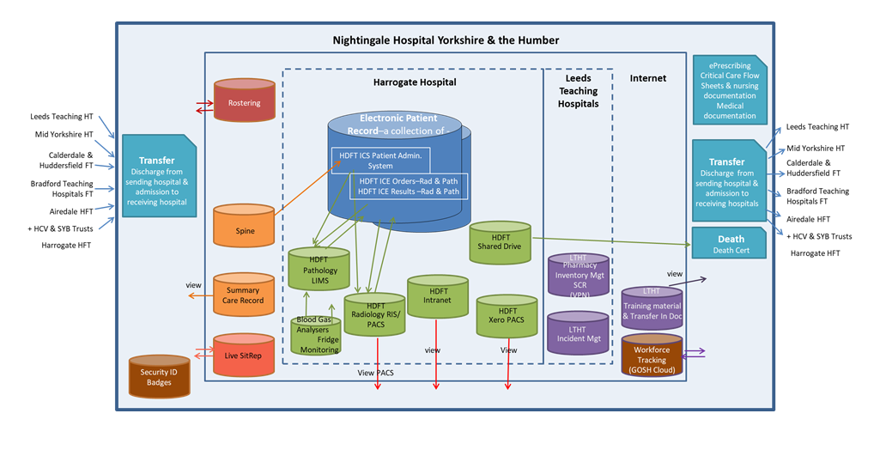
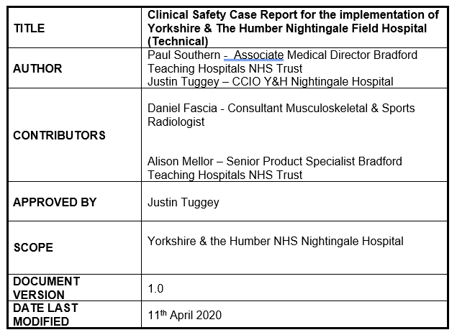

Slide 5
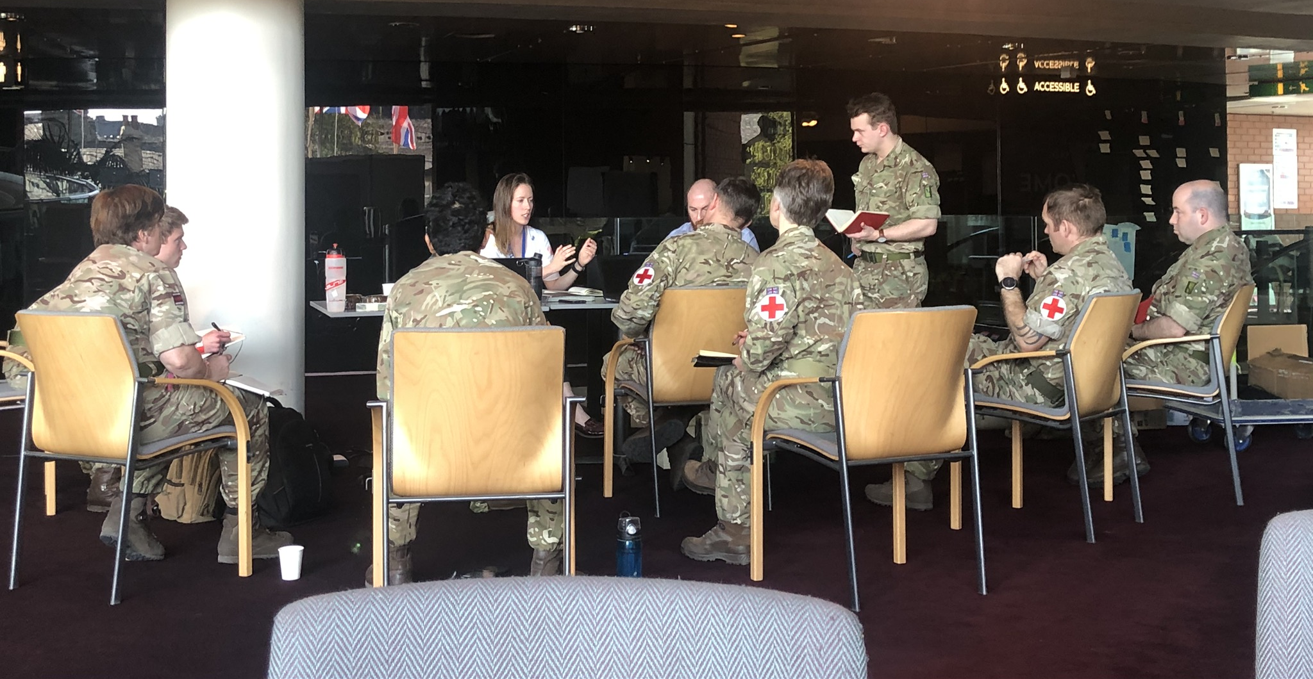
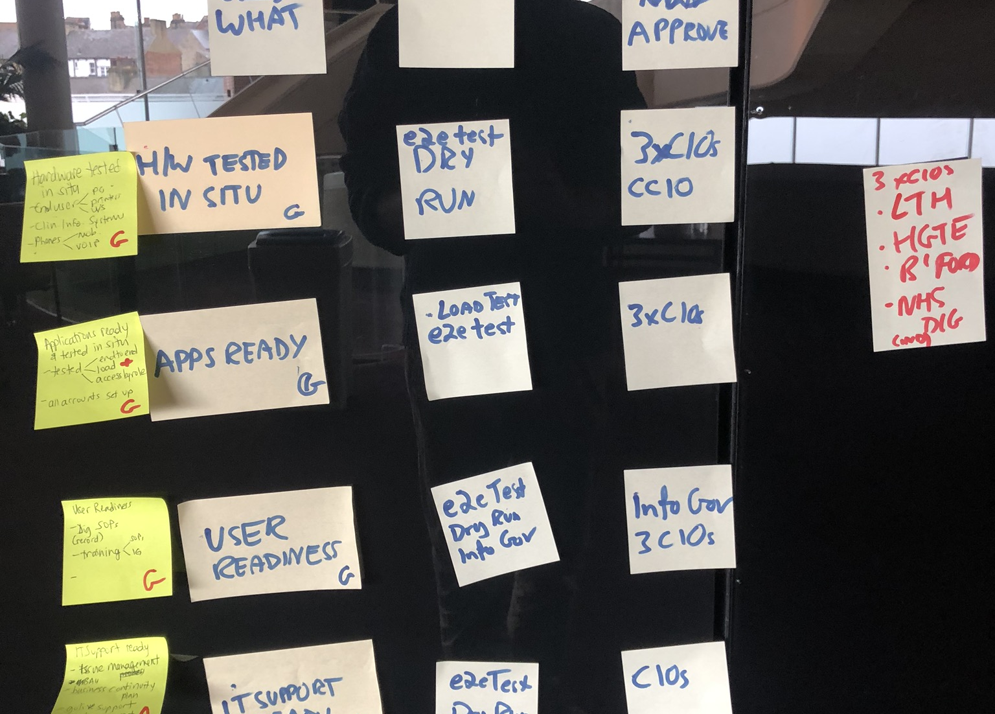
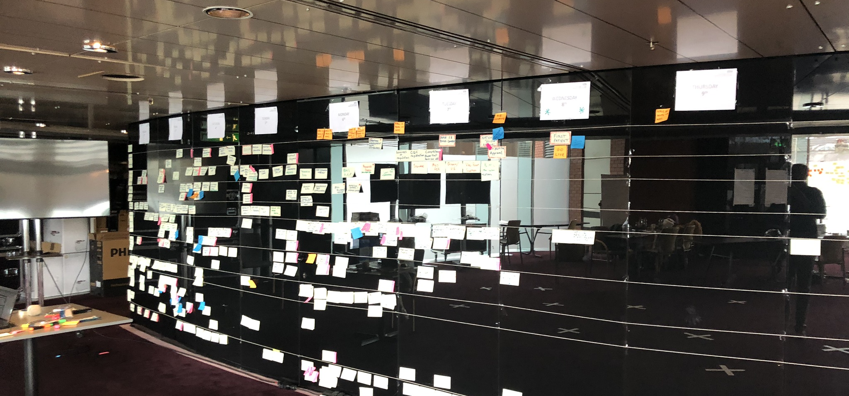

Slide 6
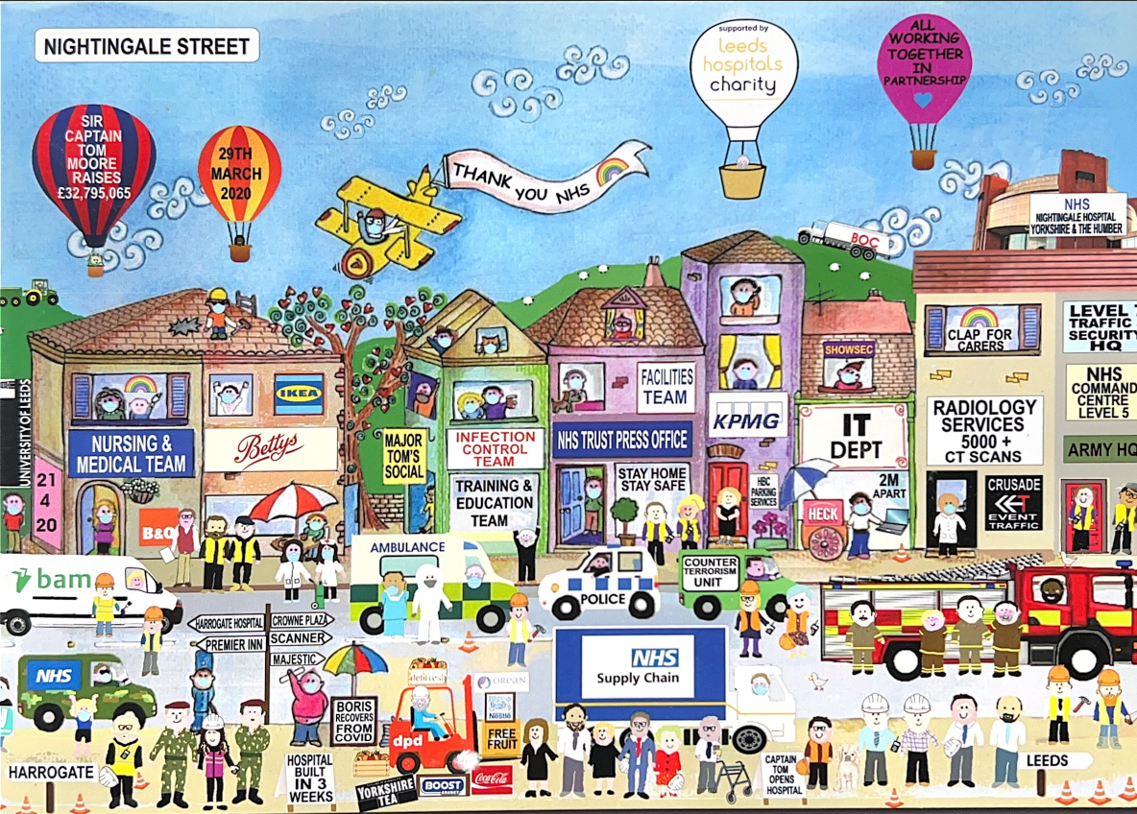

Slide 7
What is the purpose?
Wachter report (2016) ¹
Carry Out a Thoughtful Long Term National Engagement Strategy
Appoint and Give appropriate authority to a National chief clinical information officer (CCIO
Develop a Workforce of Trained Clinician-Informaticists at the Trusts, and give them appropriate resources and authority
Strengthen and grow the CCIO field
Organise Local/Regional Learning Networks to Support Implementation and Improvement
every NHS Trust should have at least 5 full time clinical ‘informaticians’ supporting a Chief Clinical Information officer
The Faculty of Clinical Informatics is the UK-wide professional body for clinical informaticians working in digital health and care
1. https://assets.publishing.service.gov.uk/government/uploads/system/uploads/attachment_data/file/550866/Wachter_Review_Accessible.pdf

Slide 8
What makes clinical informatics teams successful?
FCI survey, as little as 0.5 WTE in post and size of team did not relate to size of the organisation
What does good look like?
Clinical informatics are integrated into the wider digital and clinical workforce
are multi-professional
have a strong team identity and culture
HEE NHS worforce by 2030 ¹
Extra 12,000 WTE for clinical informatics (six fold increase)
2. https://www.hee.nhs.uk/our-work/building-our-future-digital-workforce/data-driven-healthcare-2030

Slide 9
What is our purpose?
Translator between IT and clinical staff
Between technical, clinical and information teams, suppliers
Clinical first, and person first approach
What does this mean for ‘me’
Identifying and helping to resolve issues
Unique perspective
Early insight into practice – individual and wider clinical team
Understanding impact
Resistance ‘clinicians won’t engage’
Solutions – useful, usable and used
Improving ways of working
Established member(s) of the teams
Support ‘BAU’ but also implement quality improvement
Coordinating training
Clinical safety
Clinical safety by design
Incidental management
Risk management

Slide 10
Success factors
Function vs job role
Integration with wider digital team – stronger together
physical proximity
Clinical, technical, managerial
Democratic, non-hierarchical ethos
values and behaviours within and between teams
Multidisciplinary working
Team working methods
Engagement with wider clinical workforce
Networks embedded within the clinical business units
Not just opinions, but established profession
FCI - Core Competency Framework
BCS, NHS Digital Health Leadership
Representation at Board level
Building and marketing the team

Slide 11
Next steps?
Local organisation and place:
EPR programme
Profile, CNIO
Develop a network, team
Coordinating, translating, signposting (not controlling)
Local leadership, and accountability
Digital business partners?
Shadow IT
Embed clinical safety
Clinical informatics as an ally, stronger together
Integrated Care Board:
Promote collaborative working between CIO’s, CDIO’s and CCIO’s
Supporting digital transformation through strategy
Coordination
Vibrant inclusive CCIO network
Developing clinical safety officer network

Slide 12
Questions?
How digital professionals can work as effectively as possible with clinicians (and vice versa)
What are the success factors to bring about real change
Any messages you want us to take away?
Any do's and don'ts re. clinical involvement?
How you can take on the views of your wider colleagues

