Slide 1
The Importance of the Clinical Perspective
Dr Avinash Haridas Pillai
GP Partner Riverside Surgery
Clinical Lead for Digital Primary Care, North East and Yorkshire Region, NHS England

Slide 2
Case Studies
Artificial Intelligence in Online Consultations
  AI in OC
Electronic Palliative Care Coordinating System
  EPaCCS

Slide 3
AI in OC
North Lincolnshire – 19 GP practices – 3 different OC providers
Funding for a pilot to take OC to the next level
OC algorithm to automate patient disposition based on directory of service within a Primary Care Network

Slide 4
Approach
CCG rollout team
  Set KPI
Engagement
  PLT events
  Provider events at practice level
Initial pilot phase
  2 PCNs

Slide 5
AI in OC Challenges
Tribal nature of clinicians – brand loyalty
Loss of functionality - Write back
Timing
Engagement

Slide 6
EPaCCS
EPaCCS (Electronic Palliative Care Co-ordination System) enables the recording and sharing of a patient’s care preferences and key details about their care at the end-of-life
Supports joined-up care for patients in the last months, weeks, days of life
Enables accurate up-to-date clinical summary to be:
  - Shared across care settings (community, hospital, hospice)
  - Visible in-hours and out-of-hours to trained professionals
SystmOne

Slide 7
Approach
HCV EPaCCS Clinical Design Authority
  Established requirements
  Review and approval of data set and form
  Review of EPaCCS pilot in April 2020
Information Governance and Clinical Safety
  DPIA, ISA and Privacy Statement approved by each of the 6 HCV CCGs
  Clinical Safety Risk Report completed by YHCR CSO
Initial pilot phase
  System-wide approach, including key organisations involved in delivering end-of-life care
Full roll-out
  Incorporating lessons learned from pilot phase

Slide 8
Challenges
Different people and organisations have different preferences. Our solution was based on a ‘collaborative form’ – some users love this approach, others not so much. Communications, engagement and responsiveness have been really important
If it’s not easy to access, clinical and care staff won’t use it. A separate username and password is a barrier and we’ve had to push hard for seamless contextual launch for S1 and EMIS
We worked with our clinical leads to select the solution that best met their needs – but it wasn’t perfect. Setting expectations and taking an iterative approach was really important

Slide 9
Lessons learned
...an evolving story
All of our work was underpinned by relationships
Tell people what you’re doing...and then tell them again. People move jobs, don’t always read things and learn in different ways. Comms need to be sustained and via different channels
Be clear on what good partnership looks like with your suppliers and stakeholders and lead by example
Capture lessons learned at every step
When things go wrong it’s not about blame
Use your lessons learned to constantly improve ways of working
Embed IG and clinical safety within the project from the outset, so it becomes an enabler and not a blocker
Baseline the benefits and agree how these will be captured

Slide 10
What worked well
Digital is the enabler...this was a transformation project focused on making a positive change where it was really needed.
Ongoing and sustained communications
Getting a broad range of organisations on-board – and keeping going with this.
Notes:
Clinical Design Authority with clinical champions at the get-go – without this, EPaCCS wouldn’t have happened
Getting the right people and people mix involved – clinical and care, project, transformation, exec
Sustained resourcing and continuity – this isn’t a quick fix
Digital is the enabler...this was a transformation project focused on making a positive change where it was really needed. This concept underpinned the project from the outset
The solution and functionality have developed – an iterative approach has meant we can feed back user requirements so we have a virtuous circle of enhancements
Appointing clinical leads to work ‘on the ground’ in their respective ‘places’ – partnership approach between clinical and digital teams
Ongoing and sustained communications – our monthly newsletter
Getting a broad range of organisations on-board – and keeping going with this. Some of the technical work was complex and took some time, but bringing new organisations onboard has meant a progressive increase in the value
Not leaving smaller organisations to the end of the onboarding – for example, hospices were part of the initial roll-out

Slide 11
What worked well
Clinical Design Authority with clinical champions at the get-go
Appointing clinical leads to work ‘on the ground’ in their respective ‘places’ – partnership approach between clinical and digital teams
Getting the right people and people mix involved
Sustained resourcing and continuity
Notes:
Clinical Design Authority with clinical champions at the get-go – without this, EPaCCS wouldn’t have happened
Getting the right people and people mix involved – clinical and care, project, transformation, exec
Sustained resourcing and continuity – this isn’t a quick fix
Digital is the enabler...this was a transformation project focused on making a positive change where it was really needed. This concept underpinned the project from the outset
The solution and functionality have developed – an iterative approach has meant we can feed back user requirements so we have a virtuous circle of enhancements
Appointing clinical leads to work ‘on the ground’ in their respective ‘places’ – partnership approach between clinical and digital teams
Ongoing and sustained communications – our monthly newsletter
Getting a broad range of organisations on-board – and keeping going with this. Some of the technical work was complex and took some time, but bringing new organisations onboard has meant a progressive increase in the value
Not leaving smaller organisations to the end of the onboarding – for example, hospices were part of the initial roll-out

Slide 12
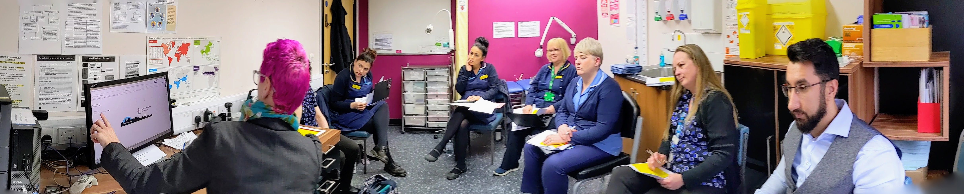
Getting the right people and people mix involved

Slide 13
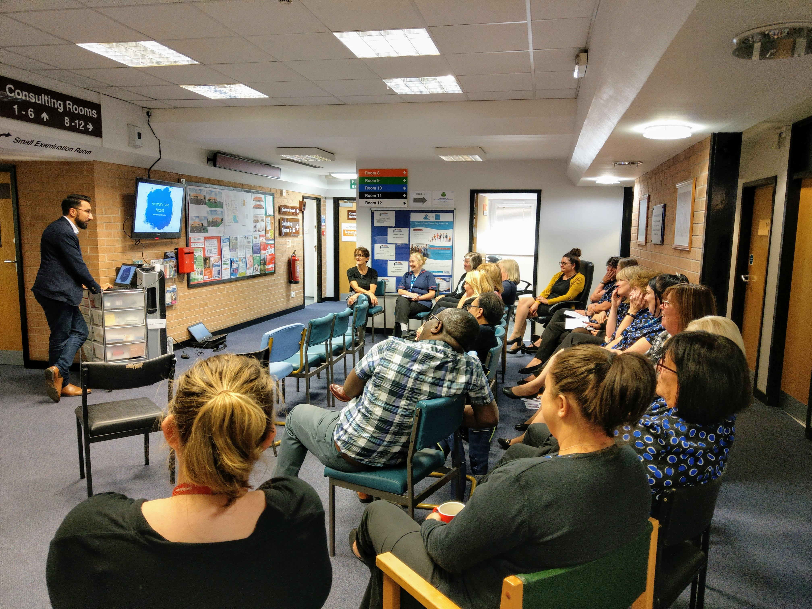
Getting the right people and people mix involved

Slide 14
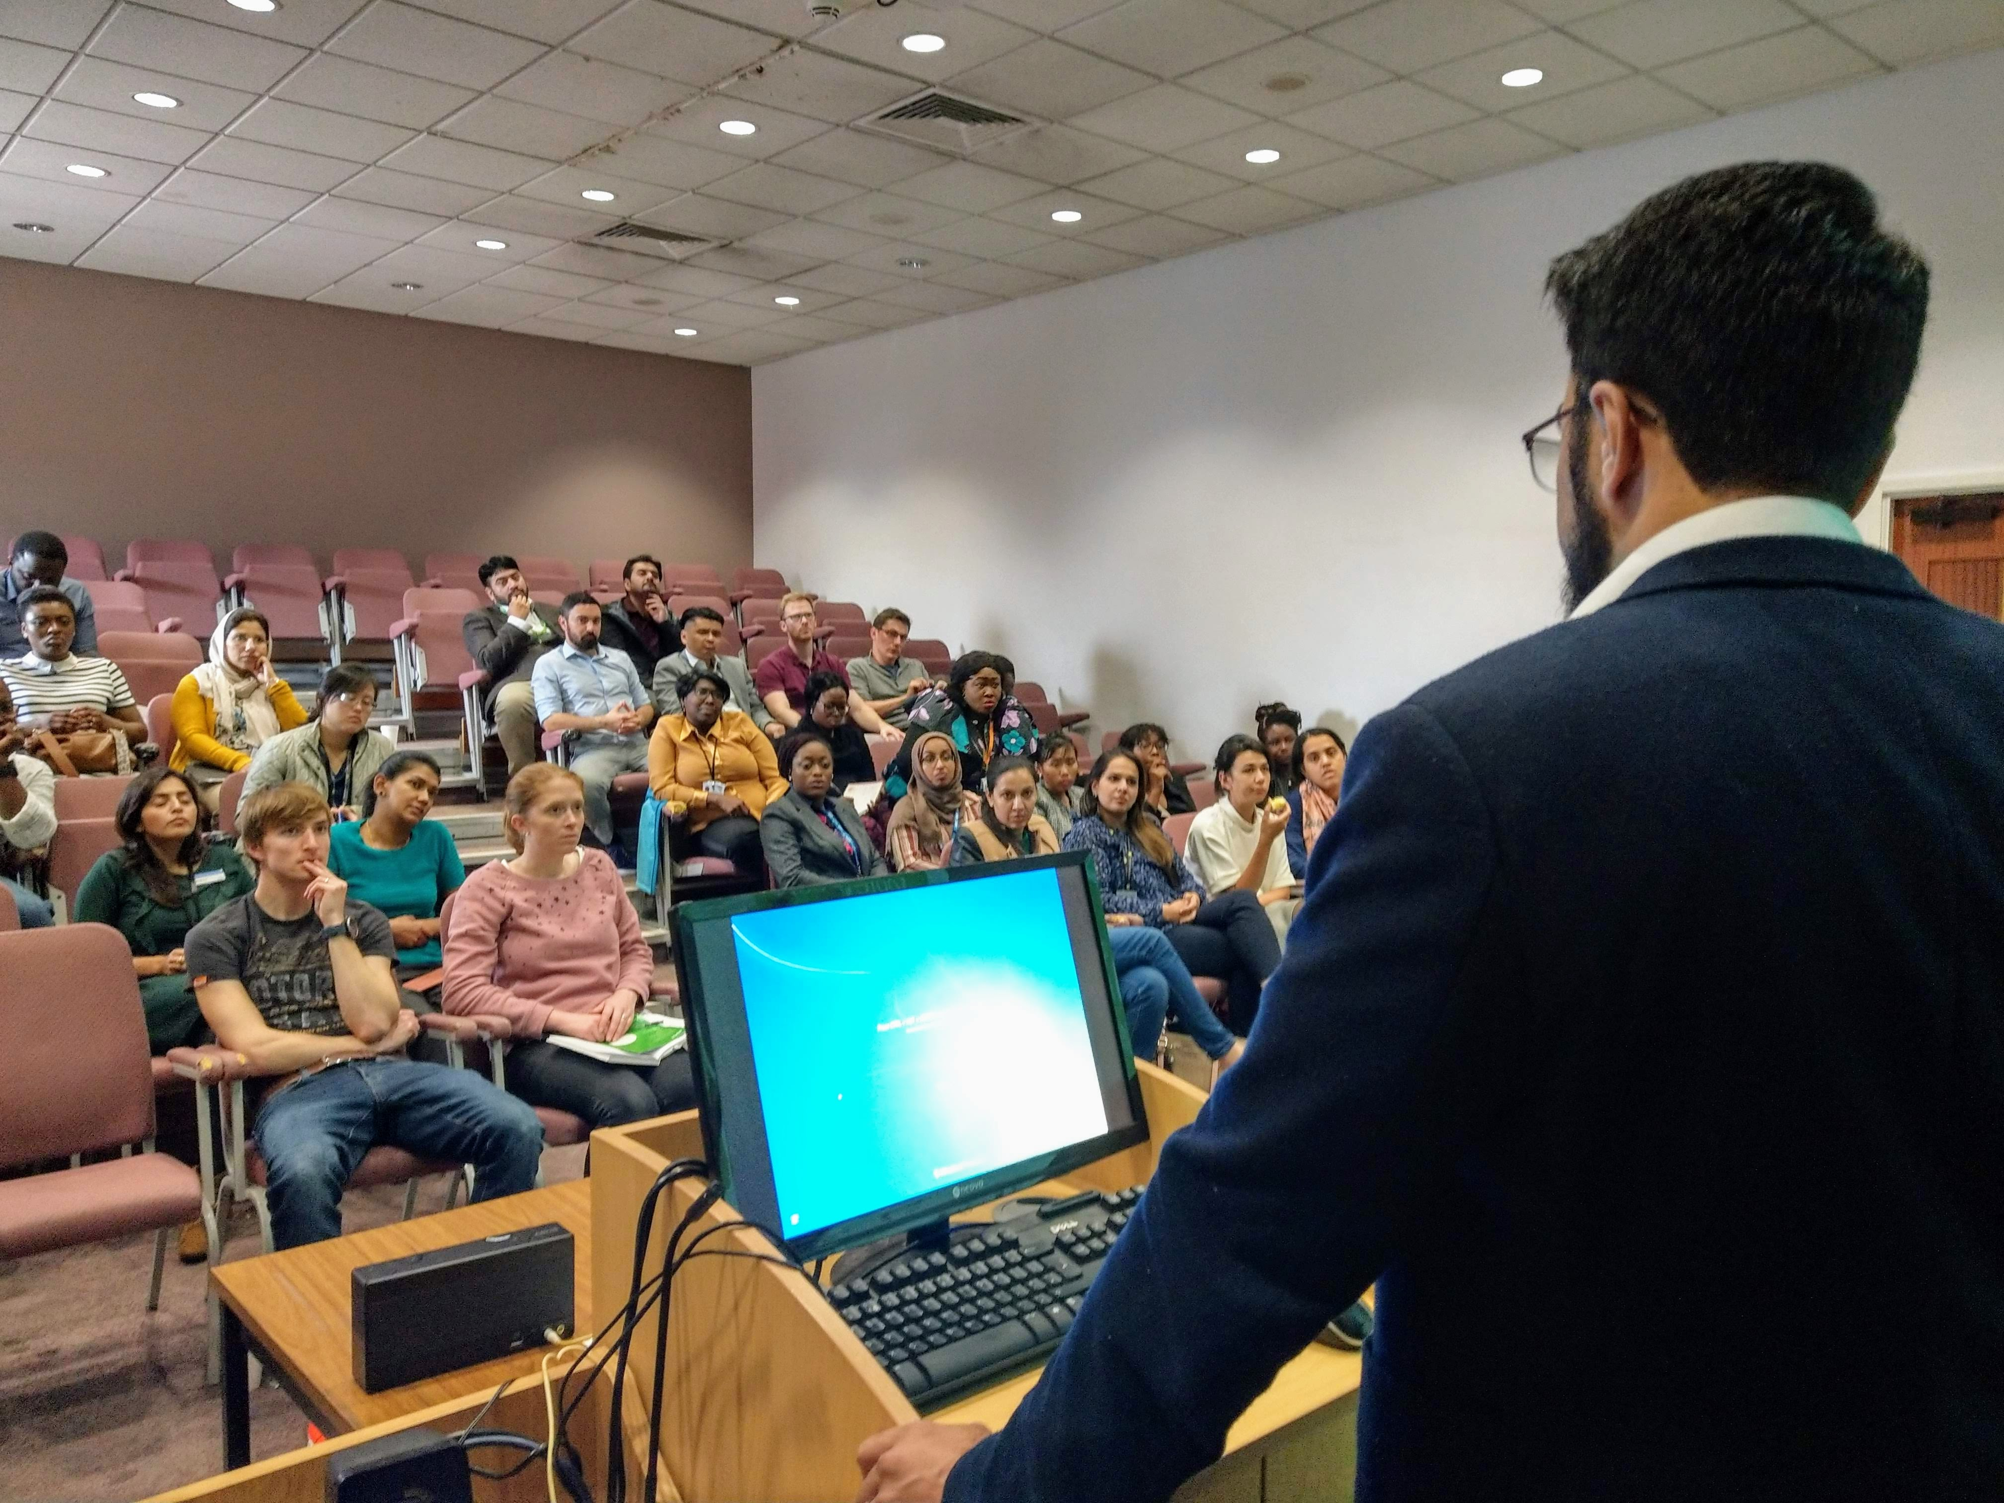
Getting the right people and people mix involved

Slide 15
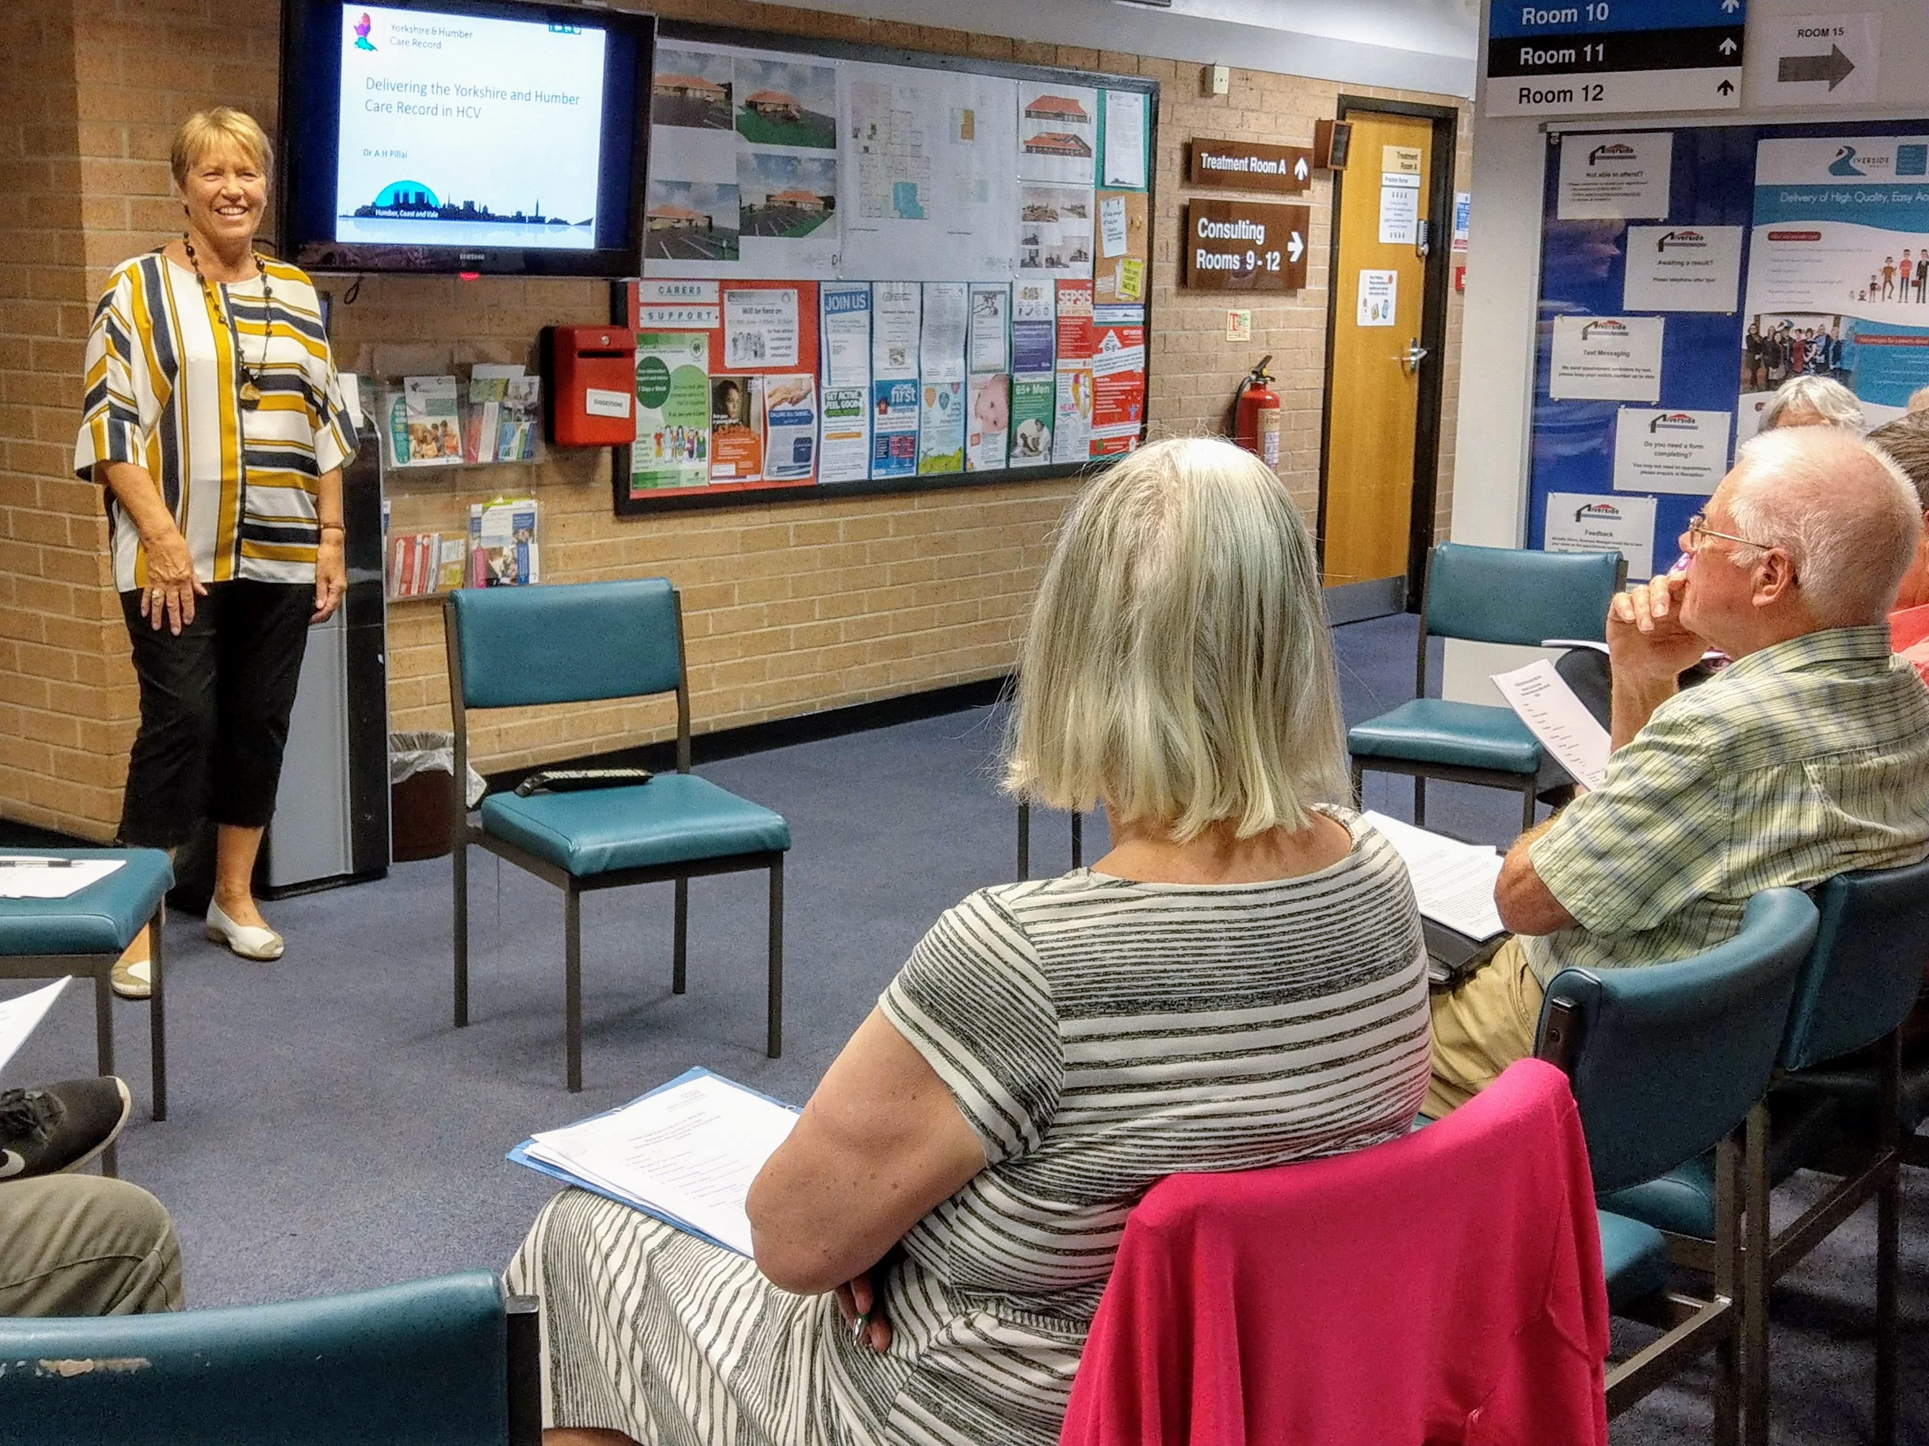
Getting the right people and people mix involved

Slide 16
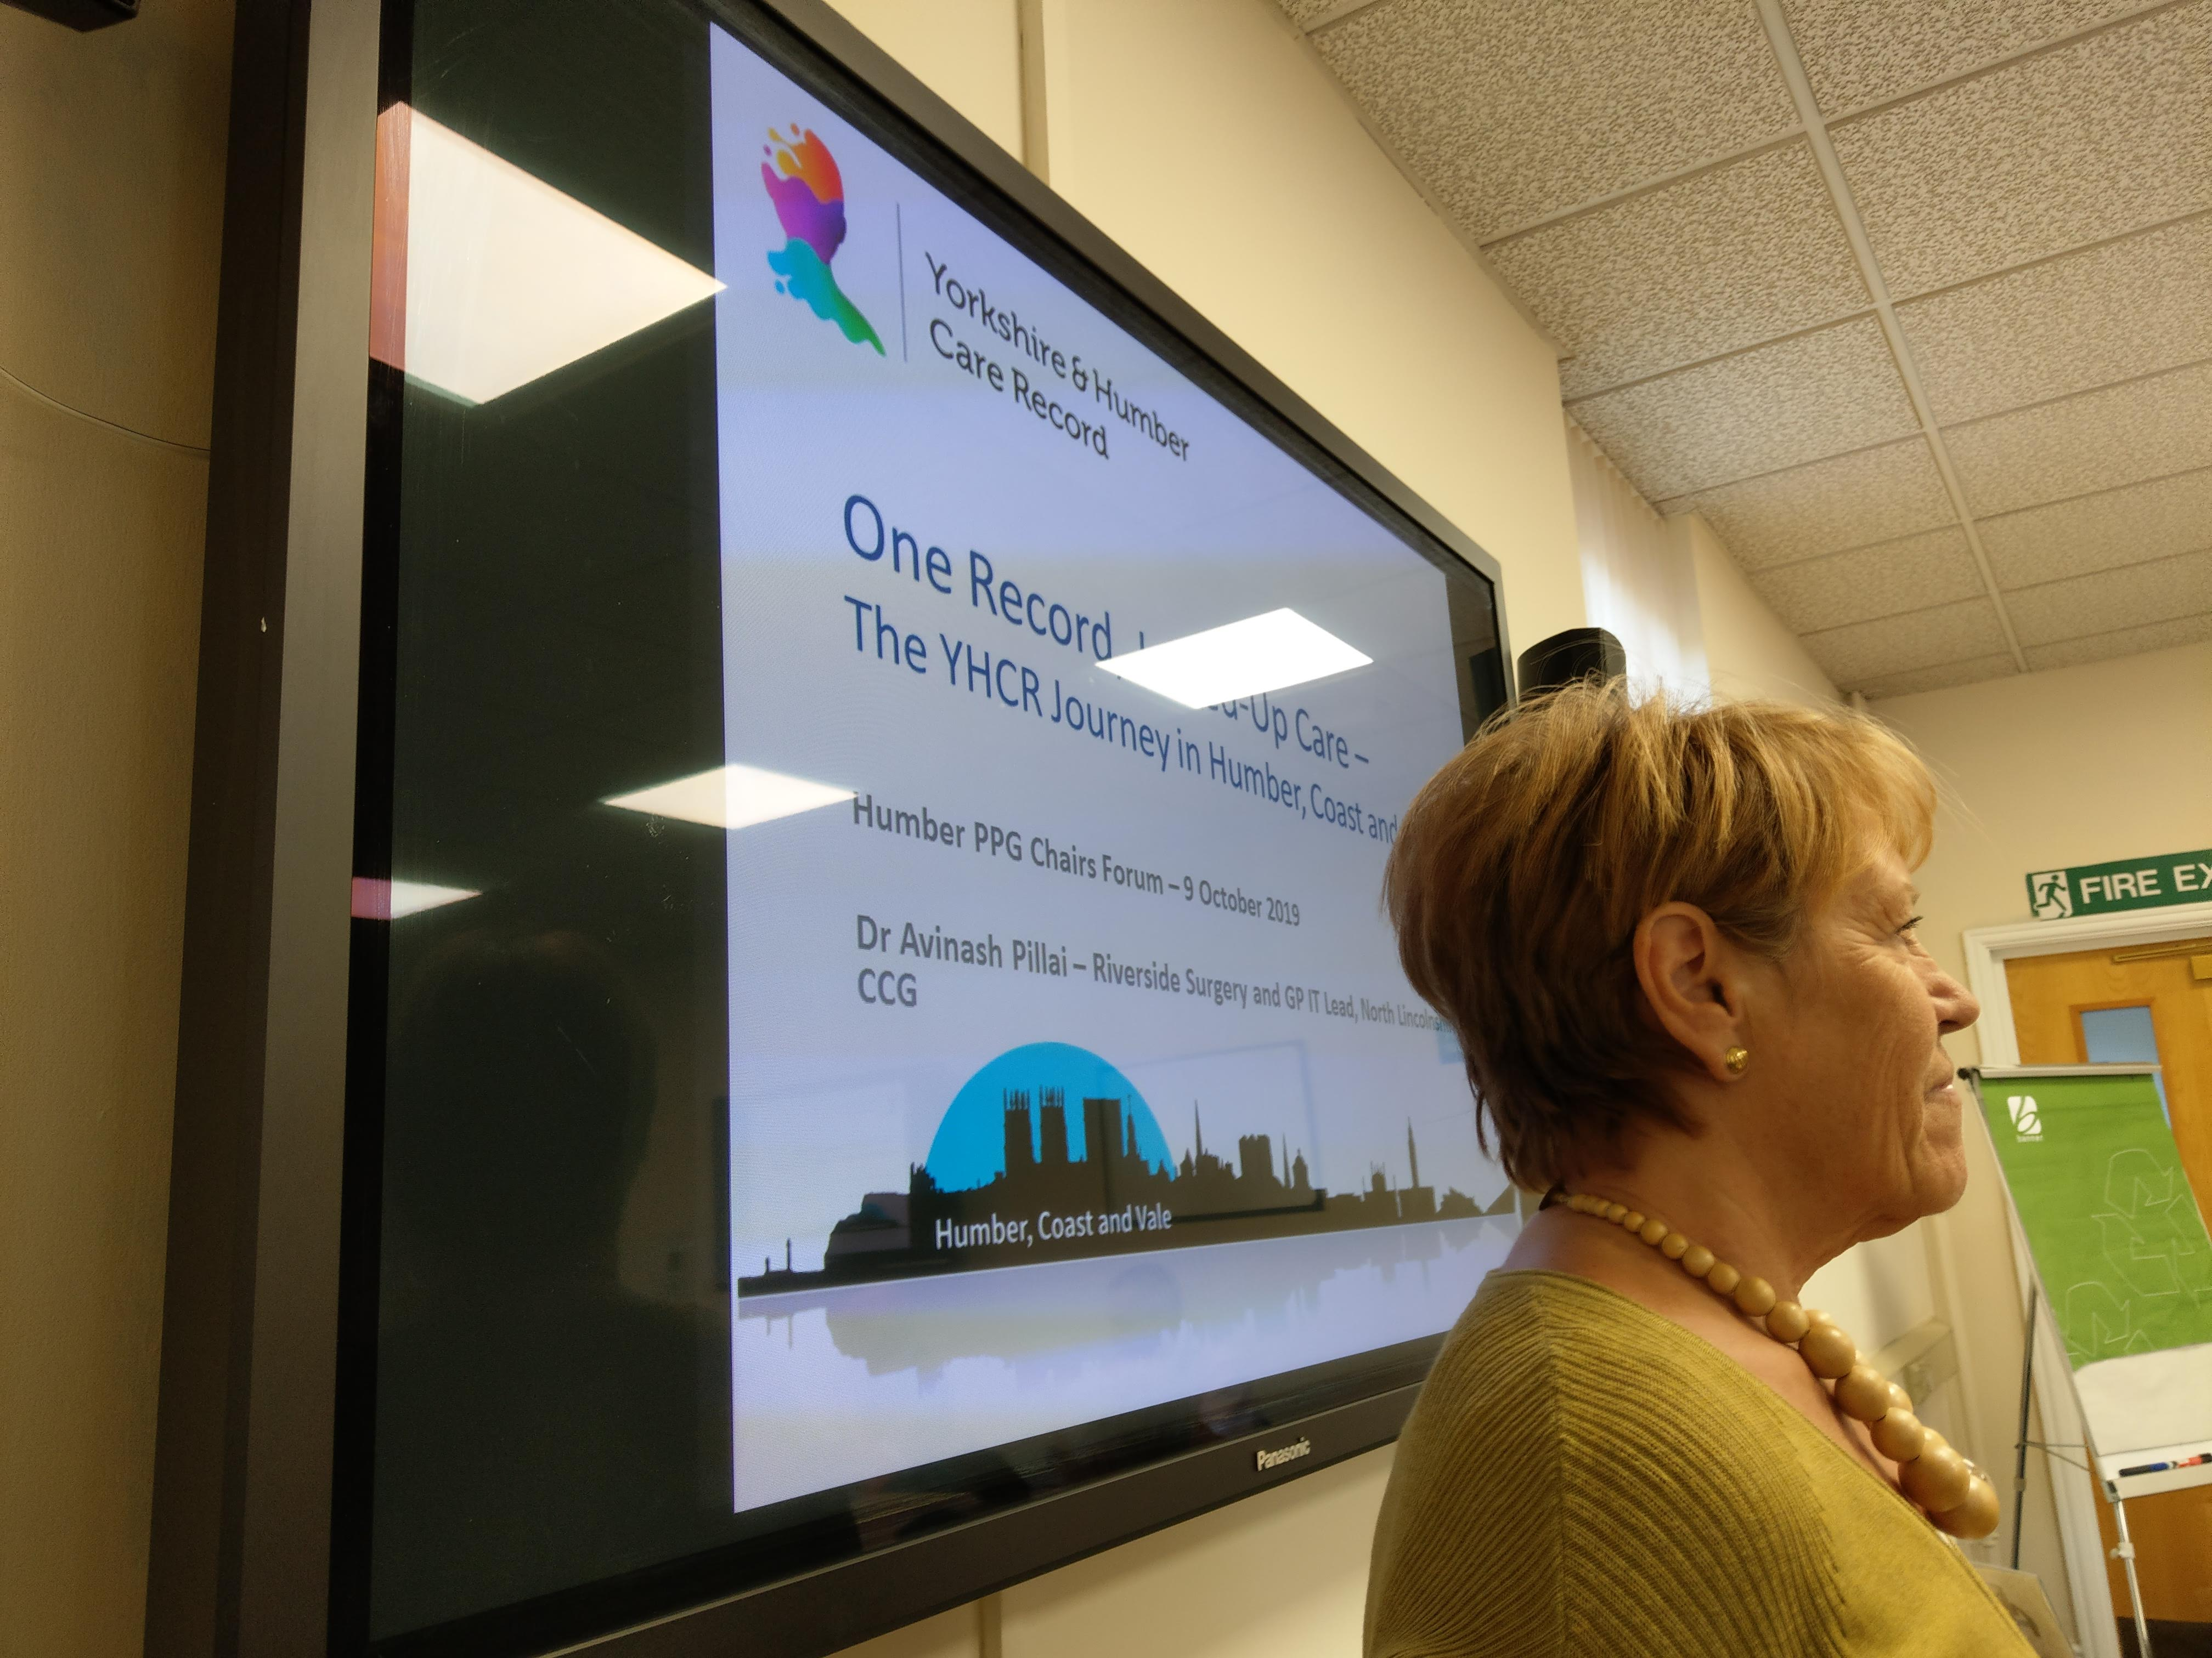
Getting the right people and people mix involved

Slide 17
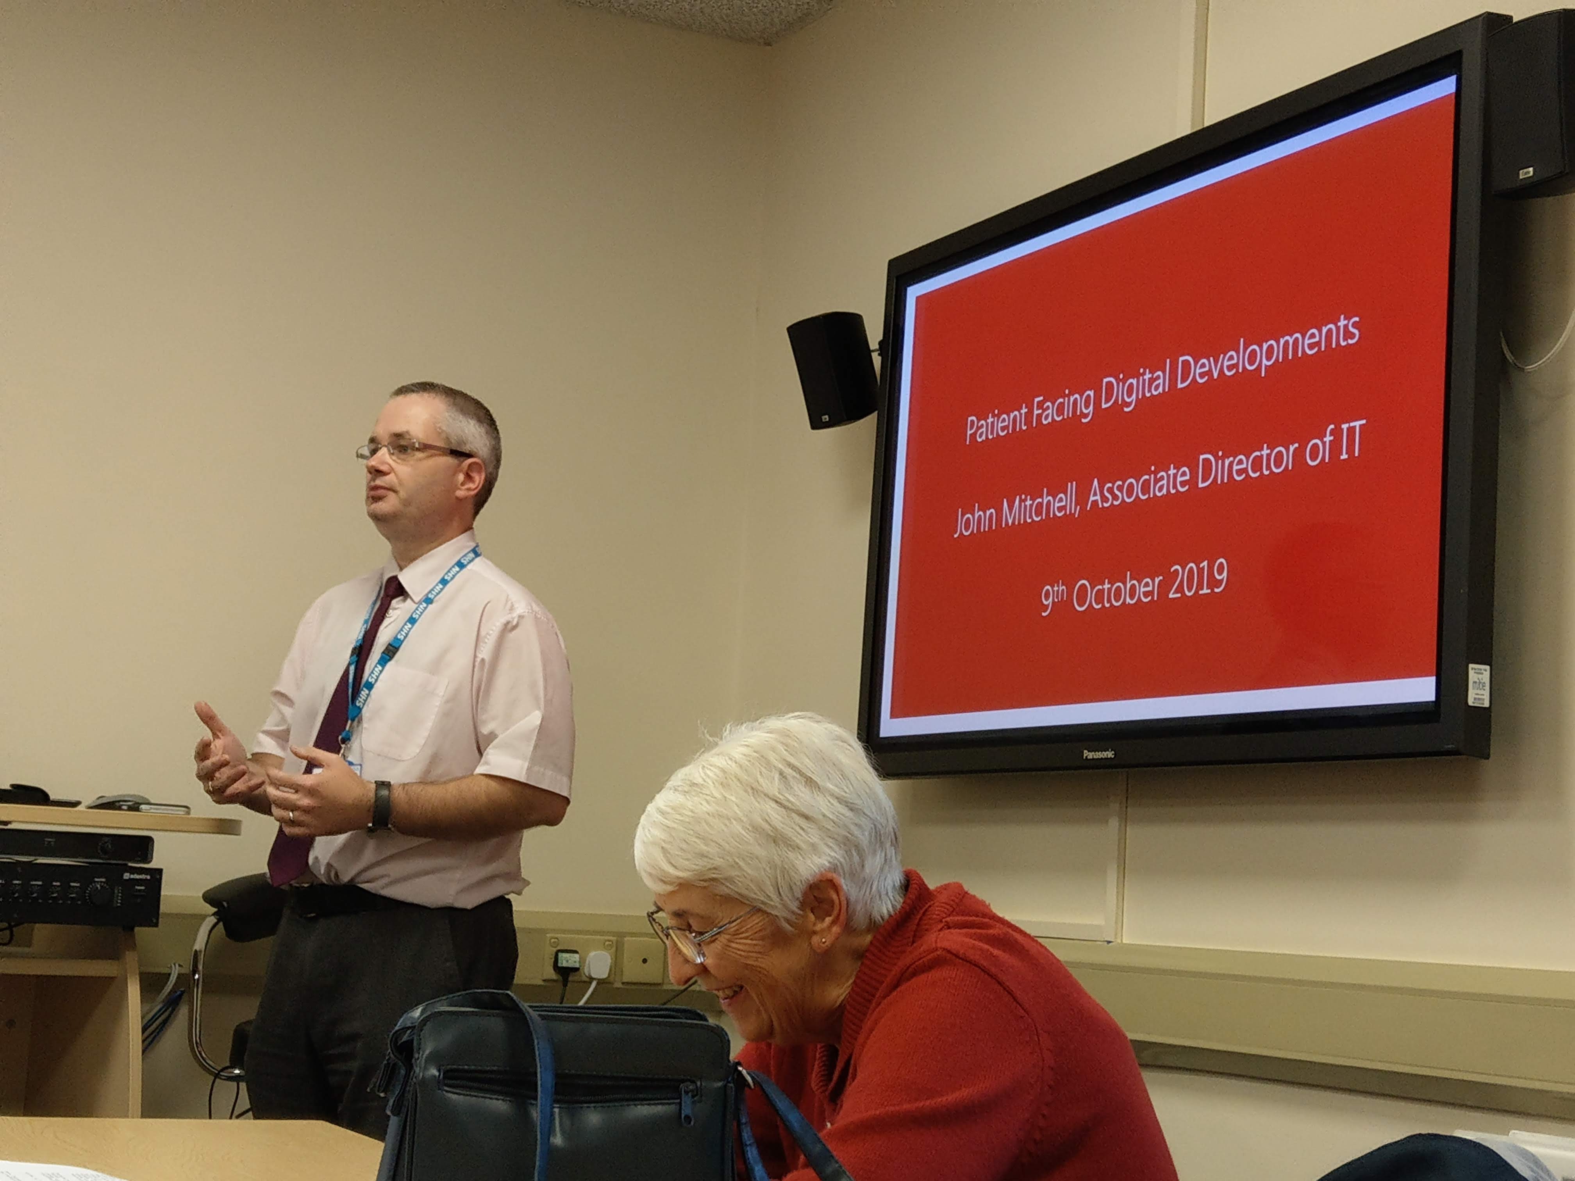
Getting the right people and people mix involved

Slide 18
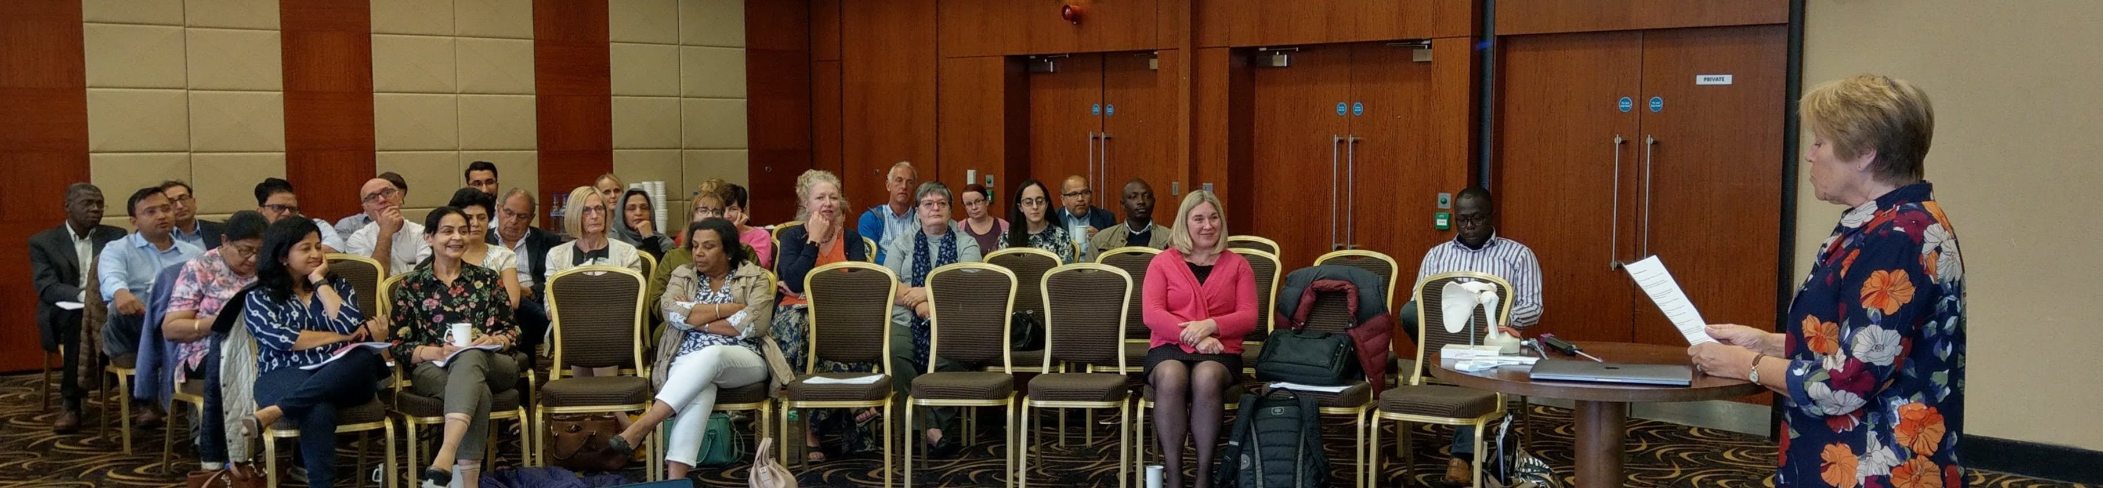
Getting the right people and people mix involved

Slide 19
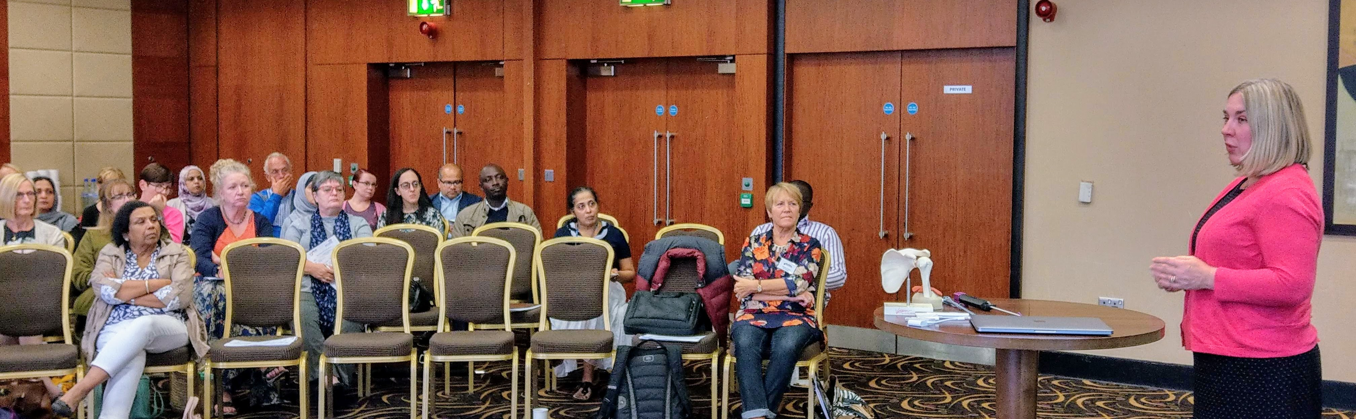
Getting the right people and people mix involved

Slide 20
Where are we today?
EPaCCS has been rolled-out to:
  GP Practices in HNY
  NHS 111
  999 – YAS and EMAS
  Out of Hours providers
  Hospitals (ED and palliative care team) – NLAG, HUTH, YSFT
  Hospices - St Catherine’s, St Leonard’s, Lindsey Lodge, Dove House, St Andrews
  Community nursing teams
Between 200-300 new EPaCCS are created each month across HNY

